Slide 1

Agentic AI with TrueFoundry
Anant Agarwal
(Principal Applied Scientist)

Slide 2
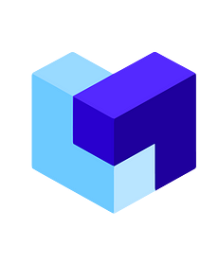
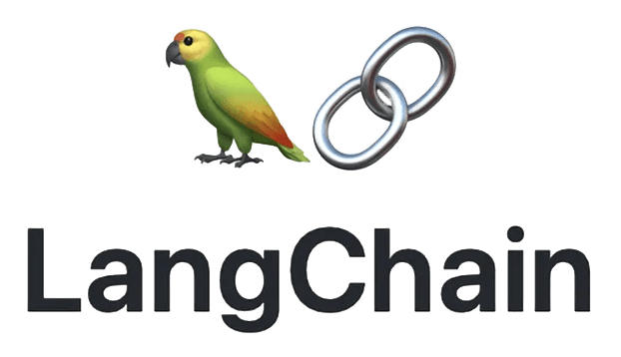
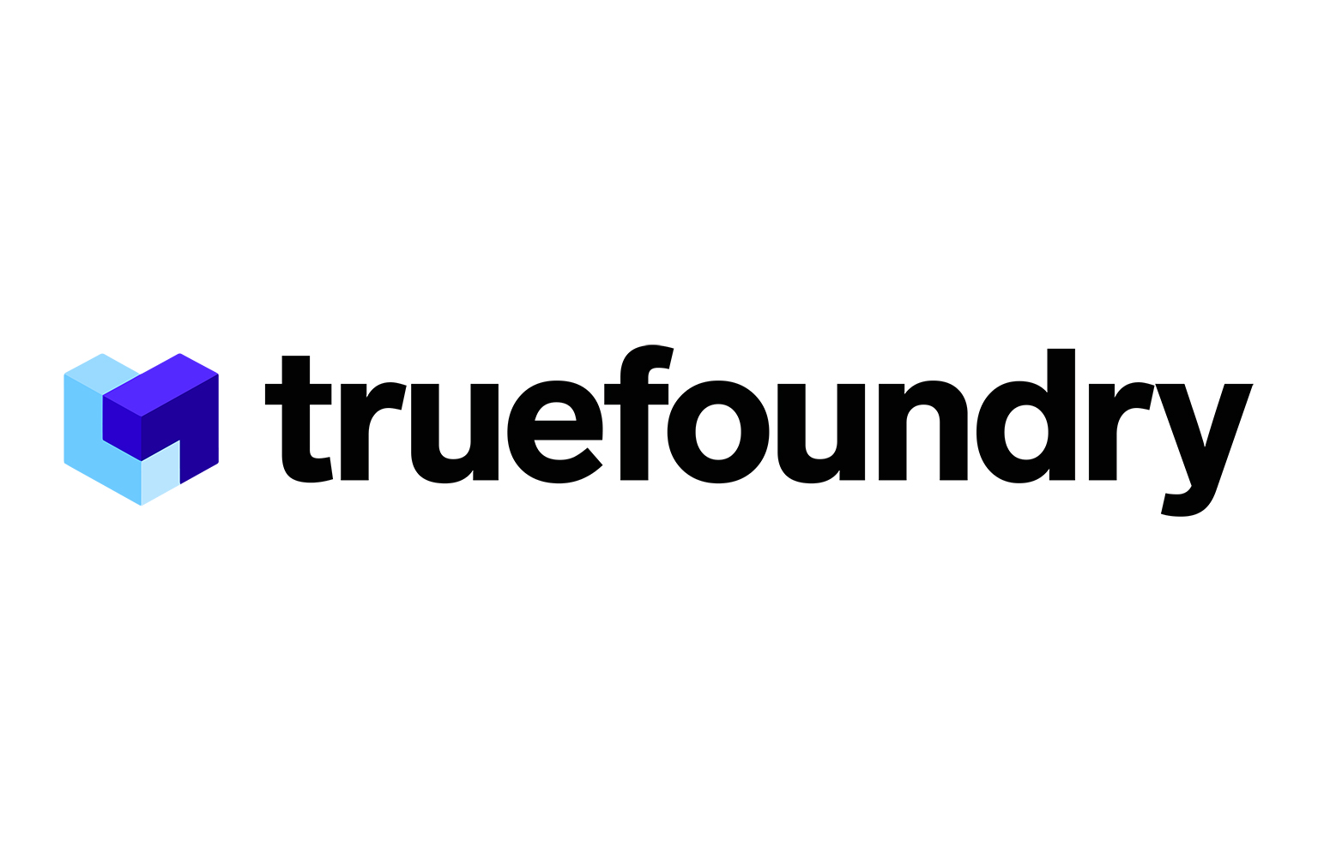



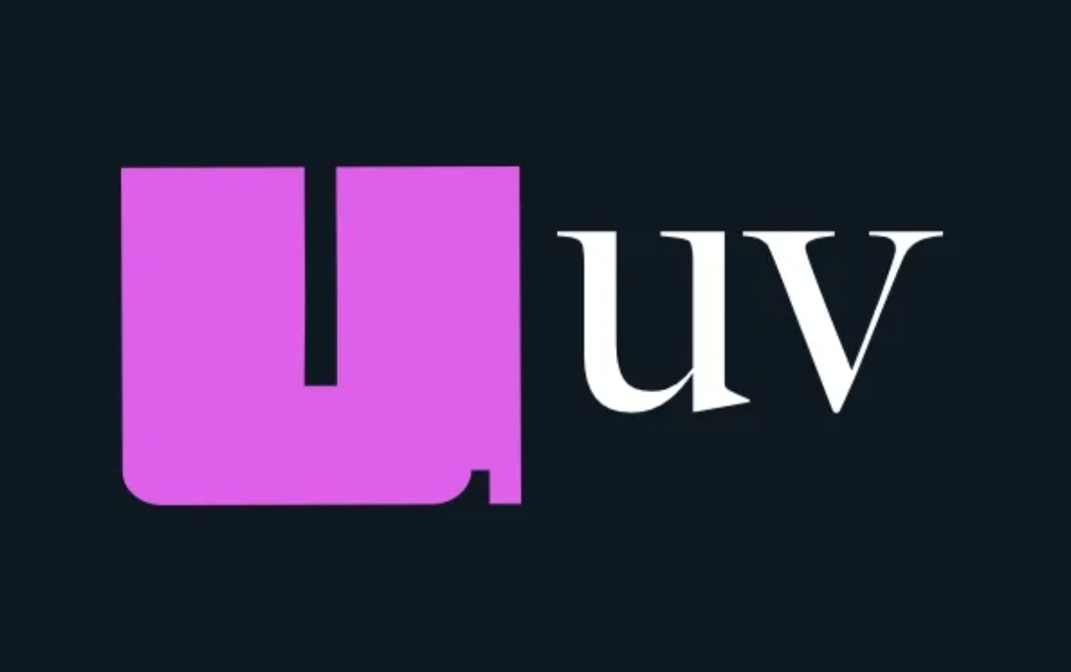



This is a hands-on course on Agentic AI, where we start with pre-agentic GenAI, then dive deep into Agentic AI and MCP development & deployment with TrueFoundry AI Gateway.
What You’ll Learn
Core Agentic AI ->
TrueFoundry Platform ->
Get Certified ->
Day 1: Primers on LLMs, LangChain, RAG
Day 2: Building Agents with LangGraph
Day 3: Agents (cont.) and MCP
Day 4: Deep-Dive into AI Gateway
Day 5: Deployment and Evaluations
Certification Test
Assessments
14%
14%
14%
14%
14%
30%
Technologies Used (feel free to experiment)
Development IDE
Agentic Search
Vector Database
LLM Orchestrator Framework
Agentic AI Deployments
Package Manager
LangChain’s Agentic AI Framework
Prototyping UI for LLM Apps
API for Accessing Models

Slide 3
Day 1: Primers on LLMs, LangChain and RAG

Slide 4
Module 0: Setup

Slide 5
Getting Started
Step 1: Clone the Repository
Clone the repository by performing git clone https://github.com/anant173/agentic-ai-with-truefoundry.git
Execute command cd agentic-ai-with-truefoundry to move into the course directory
Step 2: Setup Virtual Environment
Install uv package manager: https://docs.astral.sh/uv/getting-started/installation/
Create and activate virtual environment: https://docs.astral.sh/uv/pip/environments/
Execute command uv sync command to install all the packages
Step 3: Initialize Environment File (.env) at root
LLM API keys: OpenAI, Google, Anthropic, DeepSeek (paid, optional); Groq (free, required); TrueFoundry (given)
Other API keys: Tavily, Linkup, HuggingFace
Step 4: Install Cursor
Install Cursor IDE and open the project
Select the correct environment
And you’re set!

Slide 6
Module 1: Basics of LLMs

Slide 7

AI that grounds responses in provided context (RAG)
AI that follows instructions well (Instruction-tuning)
AI trained on huge amounts of text data (Foundation models)
Connected AI that Acts (Agents, MCP)
And
More!
THE VALUE OF GENERATIVE AI
ENGINEERING
ENGINEERING
RESEARCH
RESEARCH

Slide 8

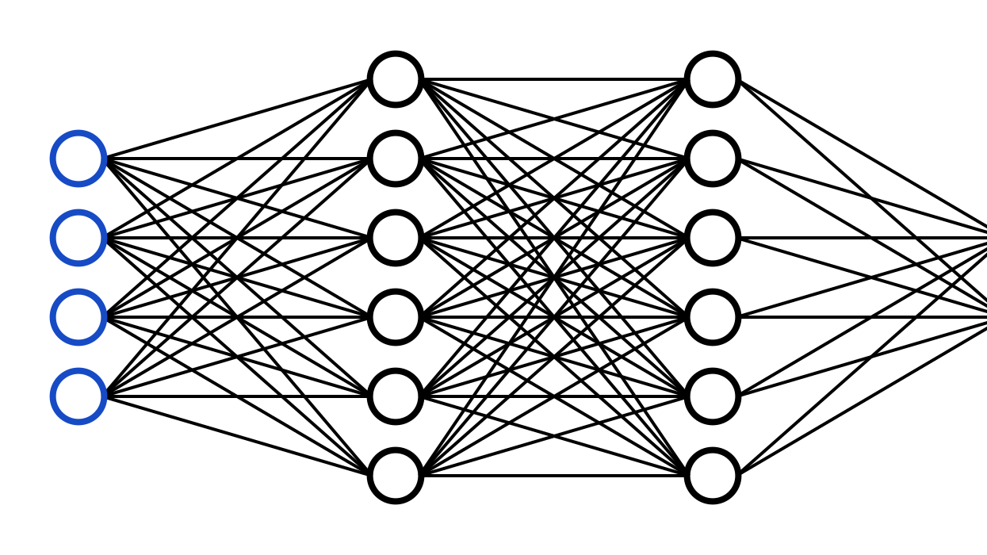
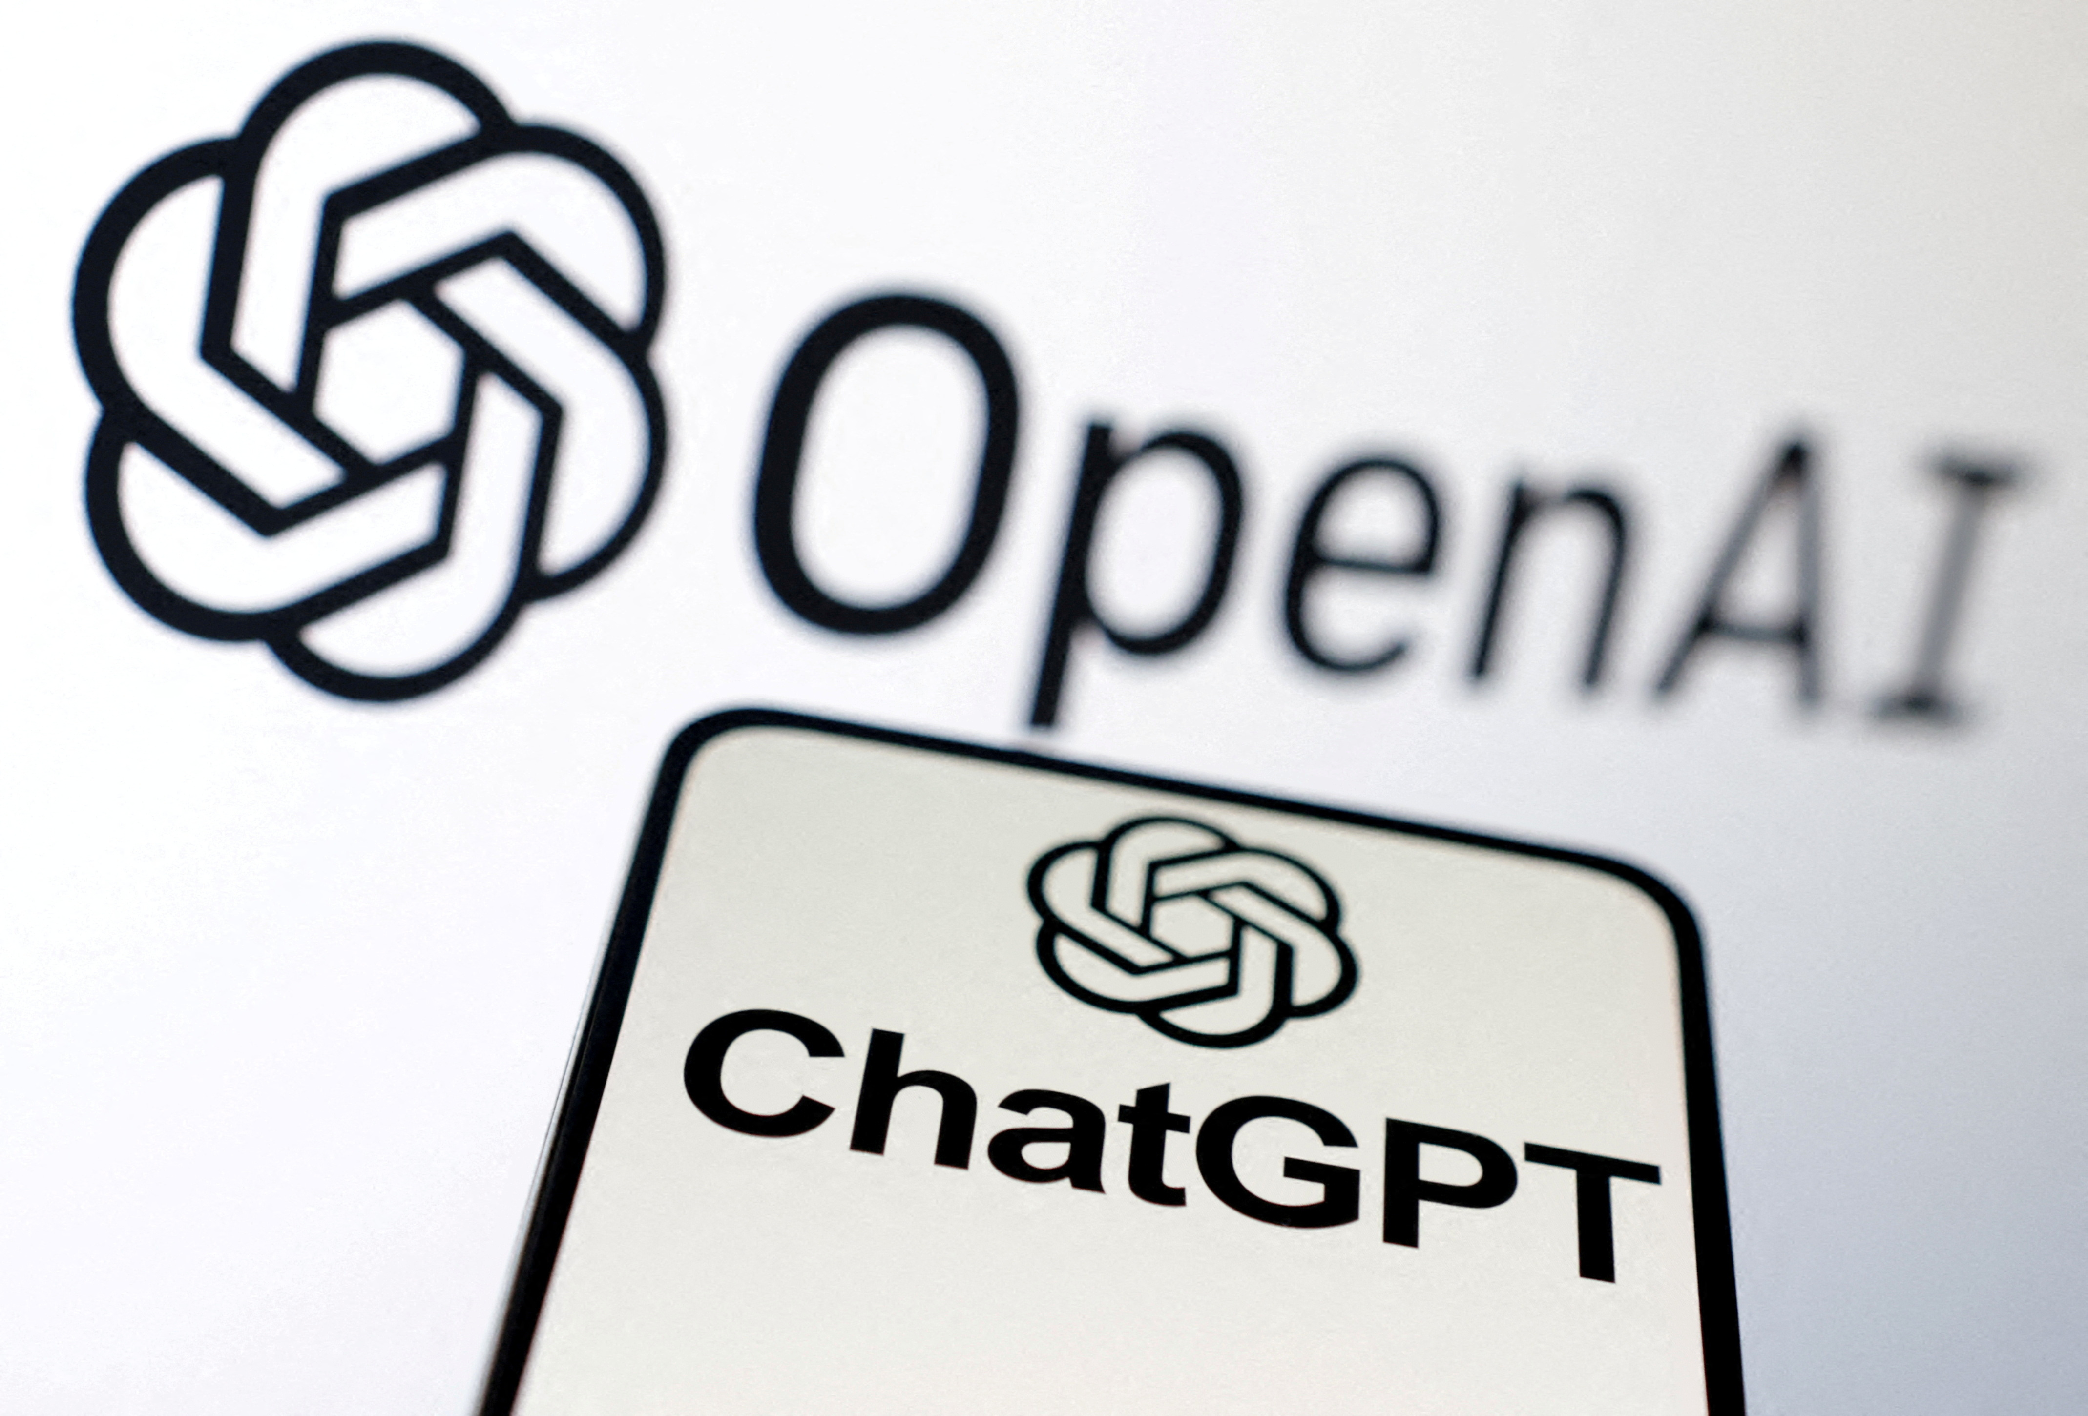
Fundamentals became stronger
First came Neural Networks…
Then Google released Transformers!
ChatGPT shook the world in Nov-22
Since then, the landscape of Generative AI is rapidly evolving!

Slide 9
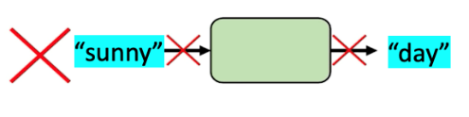
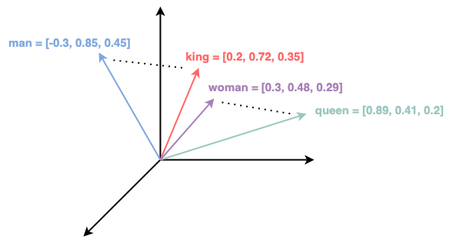
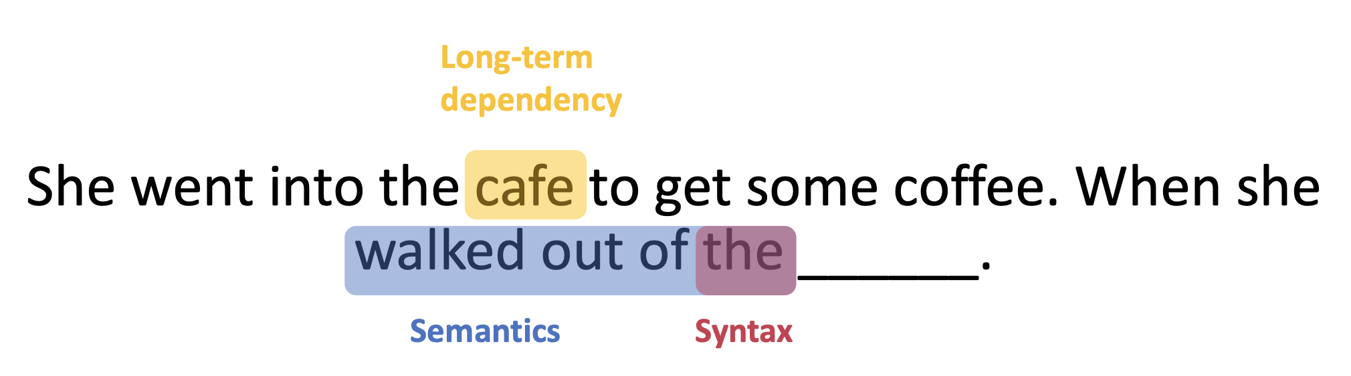
Formulating a “Language Model”
Language Modelling Problem
It was a bit hot outside, and I wanted to have cold coffee.
given these words
predict the next words
A Language Model is tasked with the objective of predicting the next few words, given a sequence of words
However, language can not be directly represented as numbers.
This is where “embedding” transforms into vectors of fixed sizes
Language models not only learn syntax and semantics, but the long-term dependencies as well

Slide 10
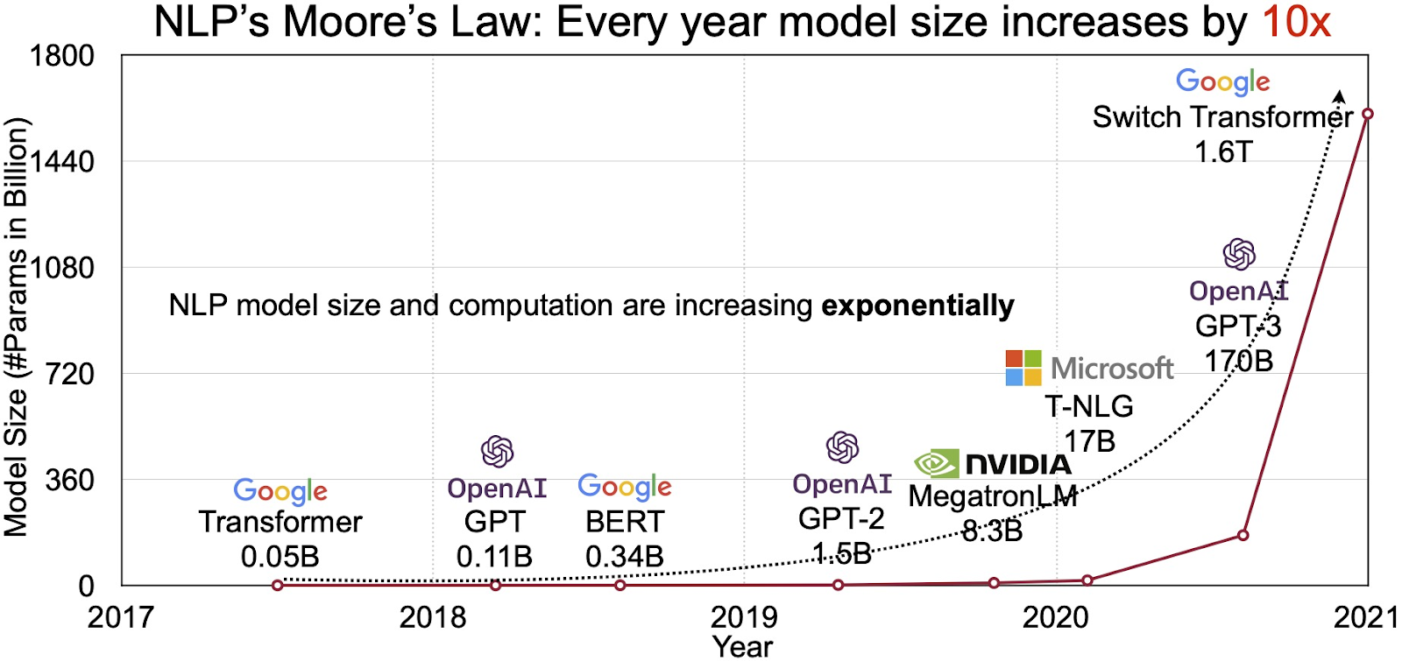
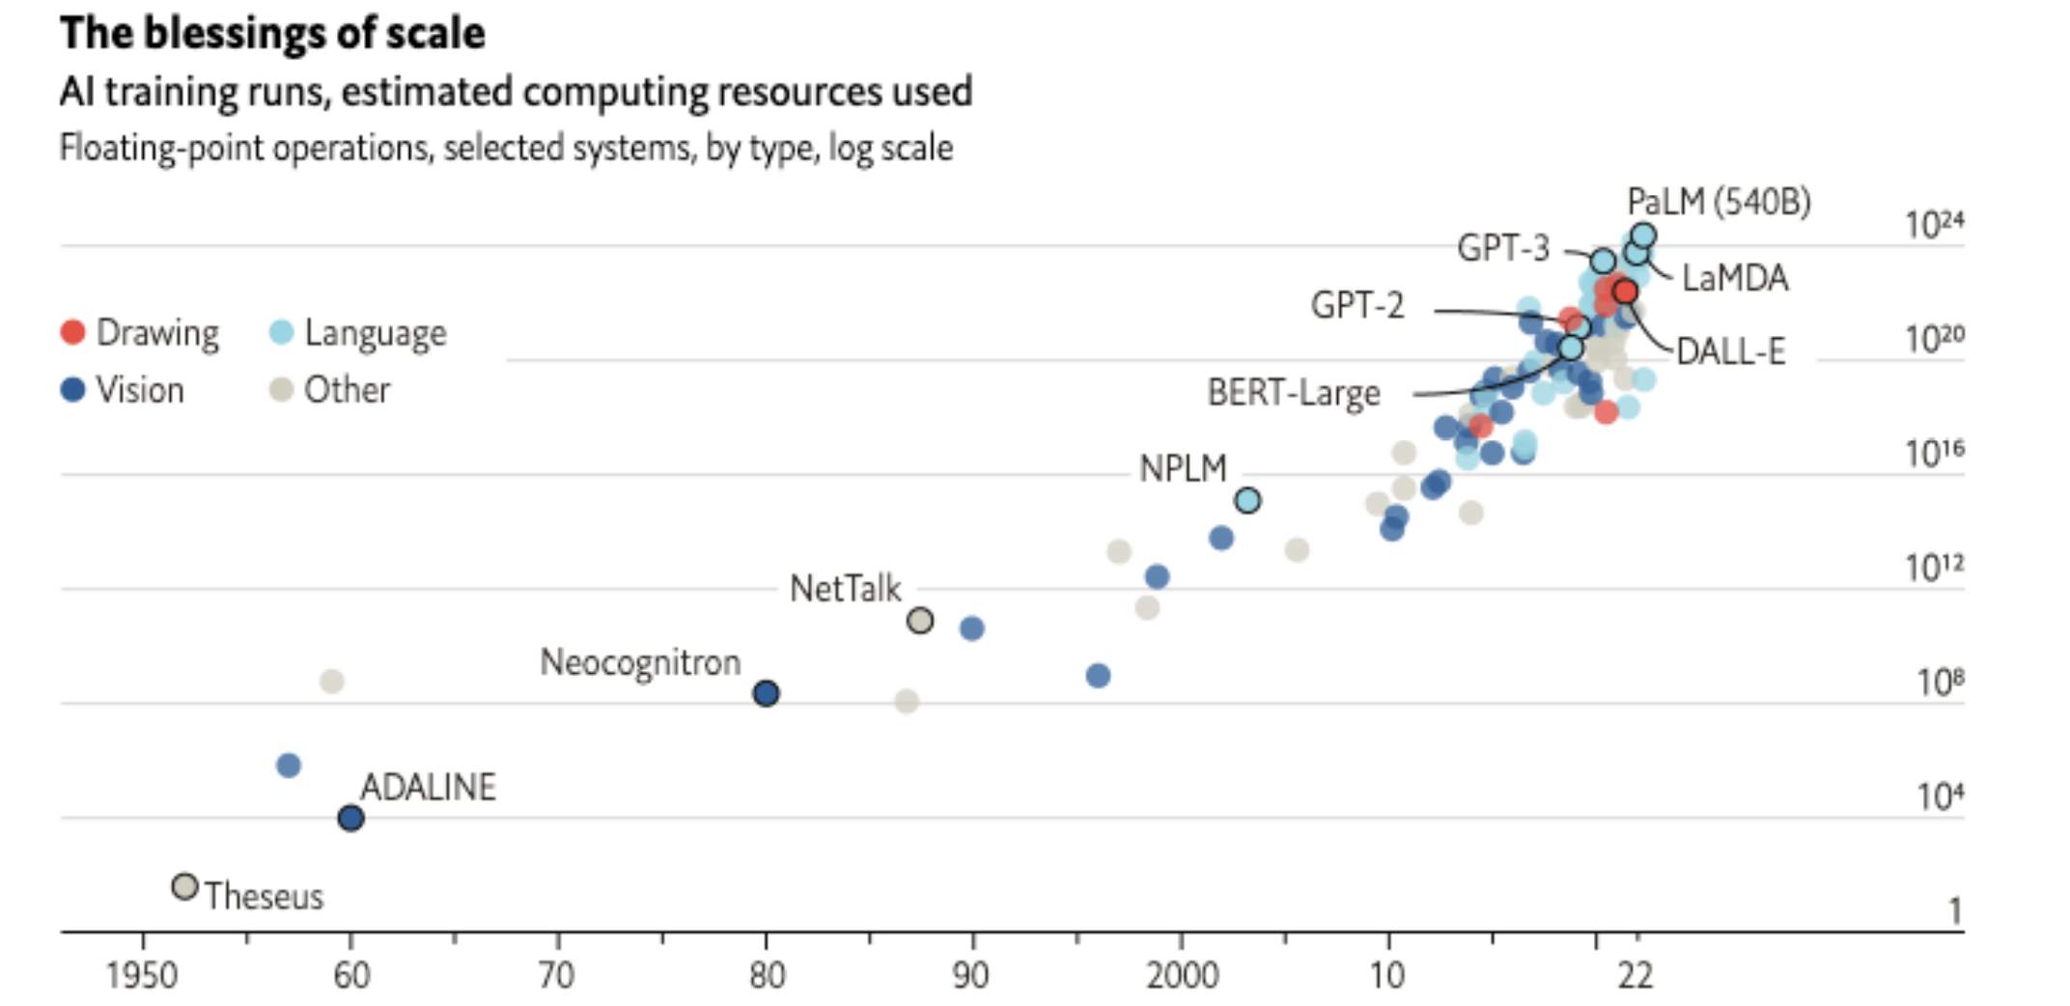
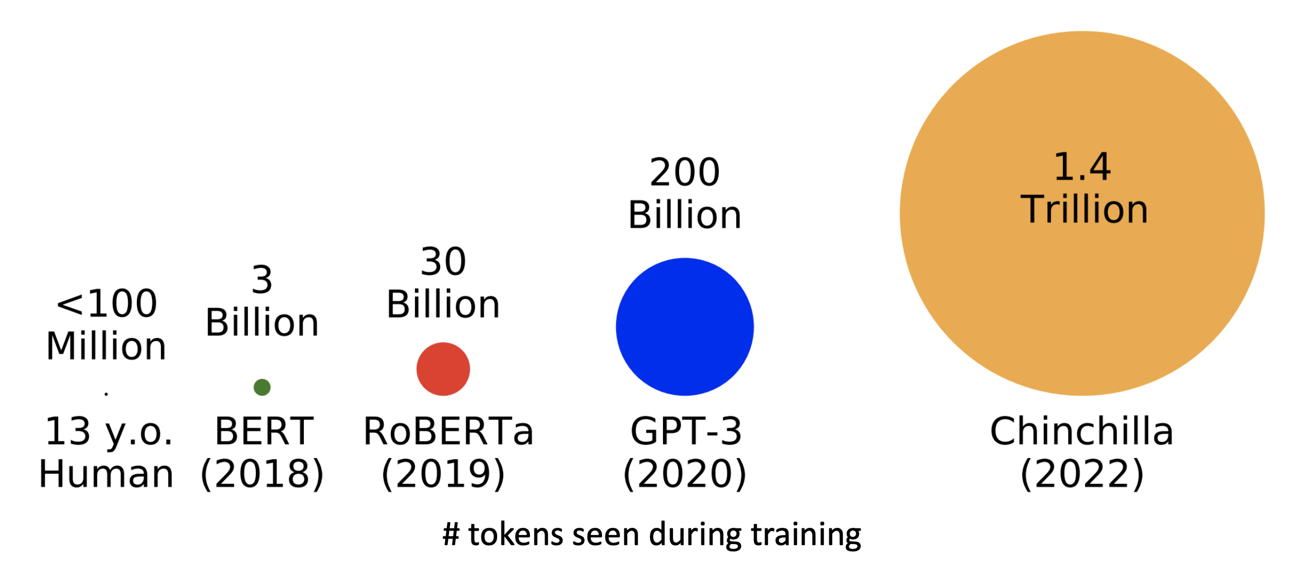
What Makes a Language Model “Large”
Number of Model Parameters
Trained on More and More Data!

Slide 11
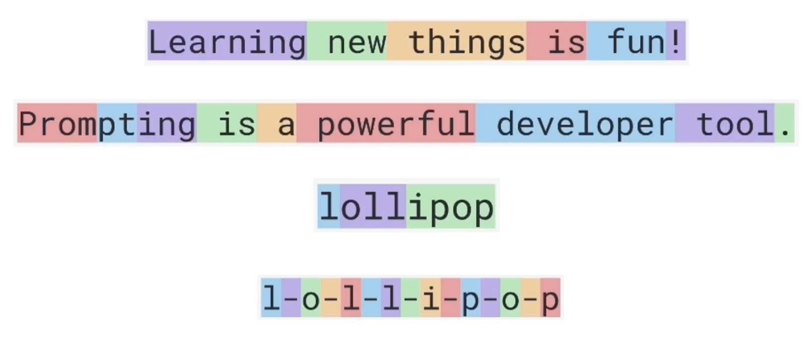
Token in the Context of LLMs
Token is the minimal amount of text used to generate text by the LLM models.
This can be a character, piece of word, word or even sequence of words for certain languages.
For English language input, 1 token is around 4 characters, or ¾ of a word.
The Byte Pair Encoding (BPE) algorithm is one of the most widely used tokenization methods in LLMs
Nice summary of other tokenizers is here

Slide 12
Hands-on Tutorial

Slide 13
Module 2: LangChain Primer

Slide 14
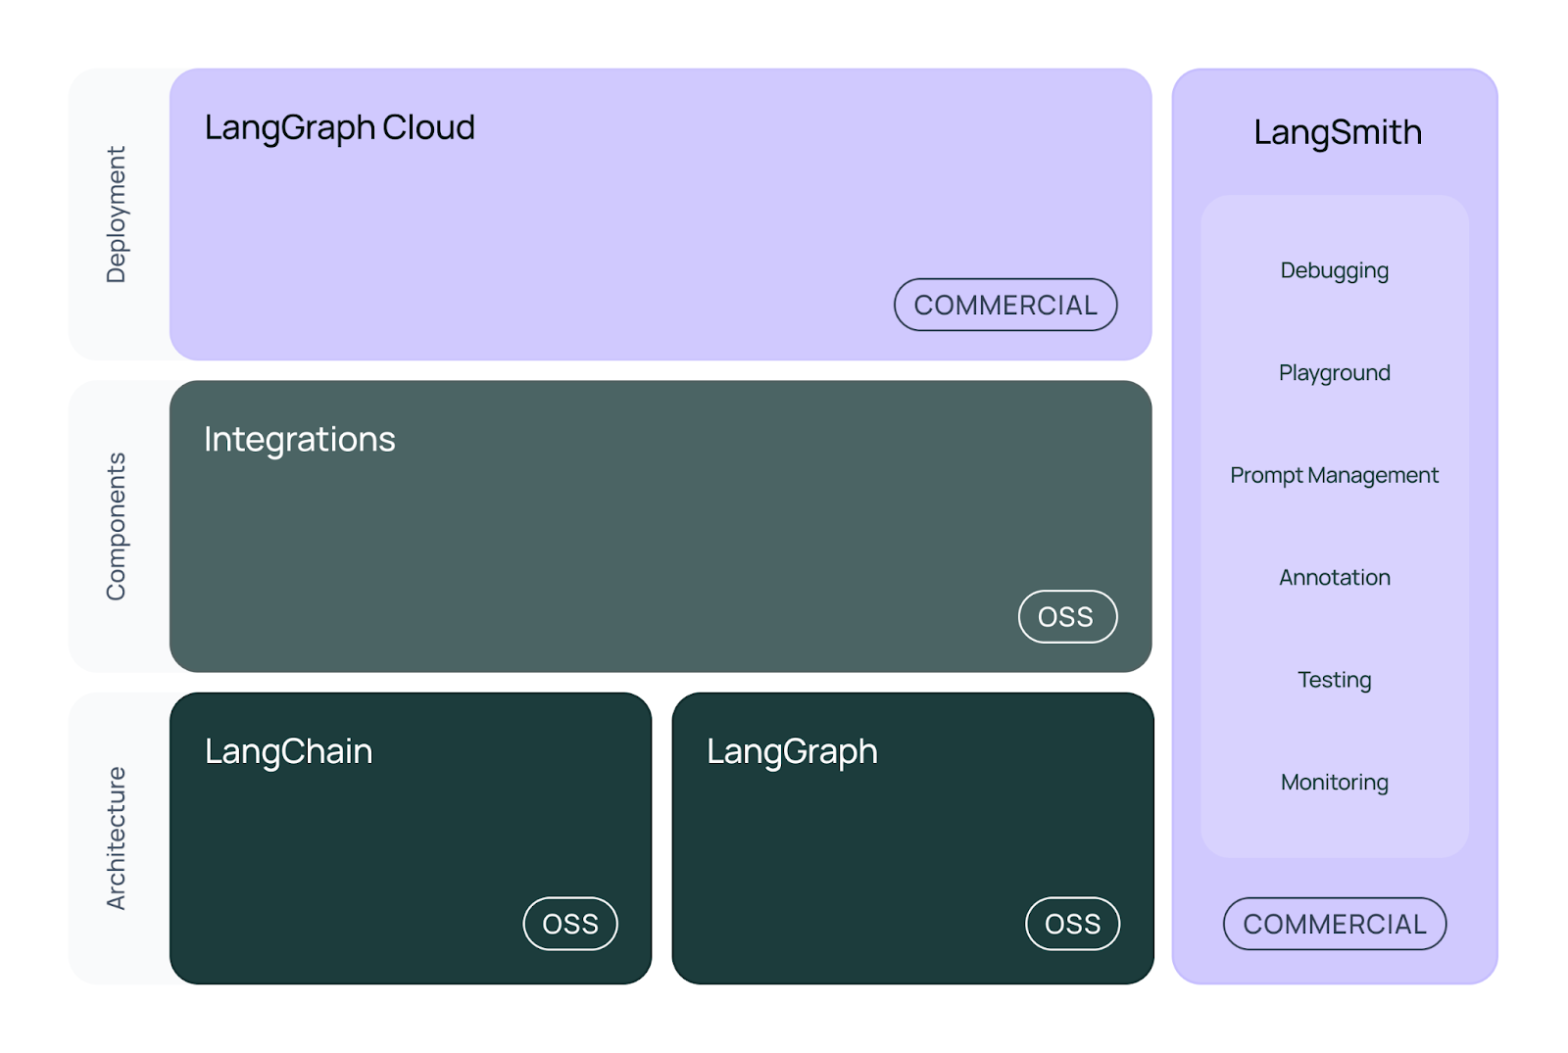
LangChain Ecosystem

Slide 15
Hands-on Tutorial

Slide 16
Module 3: RAG Deep-Dive

Slide 17
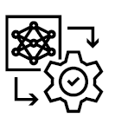
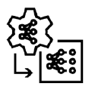


Customizing* LLMs for Tasks - Overview
Data, compute & investment
PROMPT ENGINEERING
RAG
PARAMETER-EFFICIENT FINE-TUNING
FINE TUNING
Accuracy for specific use-cases
Few-shot learning
Chain-of-thought reasoning
Least-to-most prompting
Retrieval augmented generation (RAG)
Adapters
LoRA
IA3
SFT
RLHF
TECHNIQUES
HOW
Prompt templates
Using vector databases
Add “custom” layers to LLM
Tune LLM model weights
Adapted from Nvidia Research with a few changes
*Note that this is called “finetuning” loosely, and even Prompt Engineering and RAG can be considered as finetuning for your application - a common understanding of the word “finetuning”

Slide 18
What We Know
This is how you could typically chat with an LLM:
User Prompt
LLM
Output
But how do you arm LLMs with the domain-specific / org-specific information you want it to refer to, rather than its own general training data knowledge? This is the common use case that we’ll focus on today.
User Prompt
LLM (with document information)
Output
How do you think this would work?

Slide 19
Introduction to RAG
User Prompt
LLM (with document information)
Output
Retrieval Augmented Generation (aka RAG) is how it’ll work.
Let’s expand our flow.
User Prompt
LLM
Output
GENERATION
RETRIEVAL
Similarity
Search
Context
AUGMENTATION
Knowledge Base

Slide 20
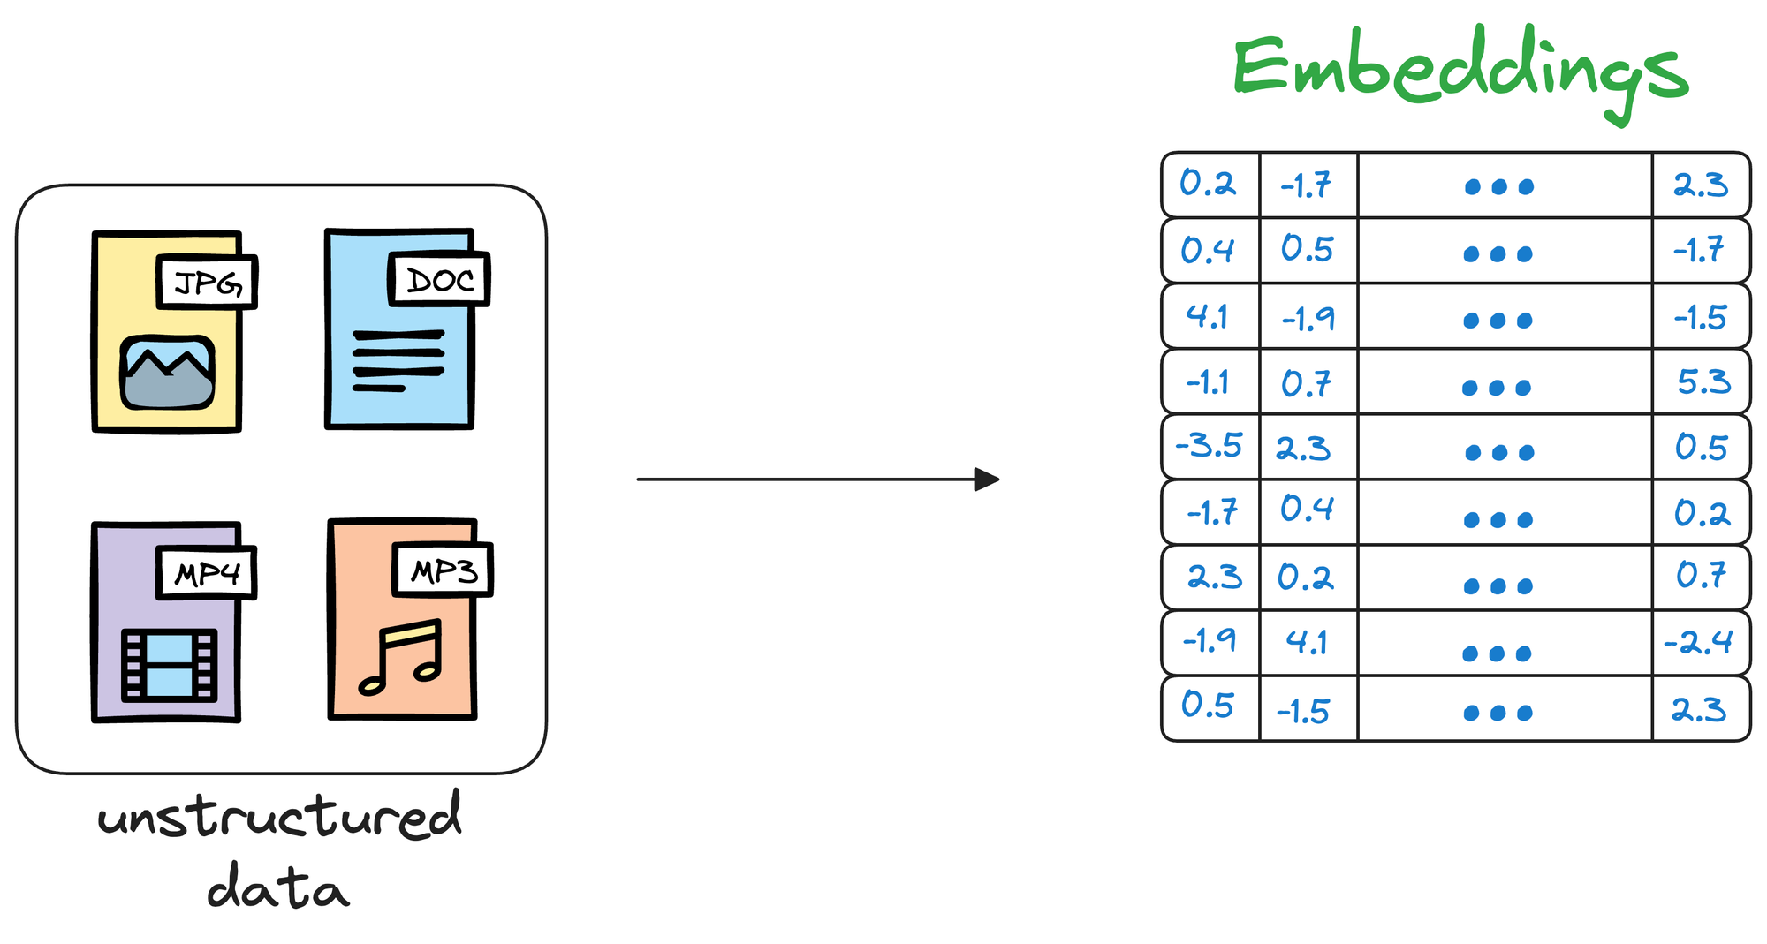
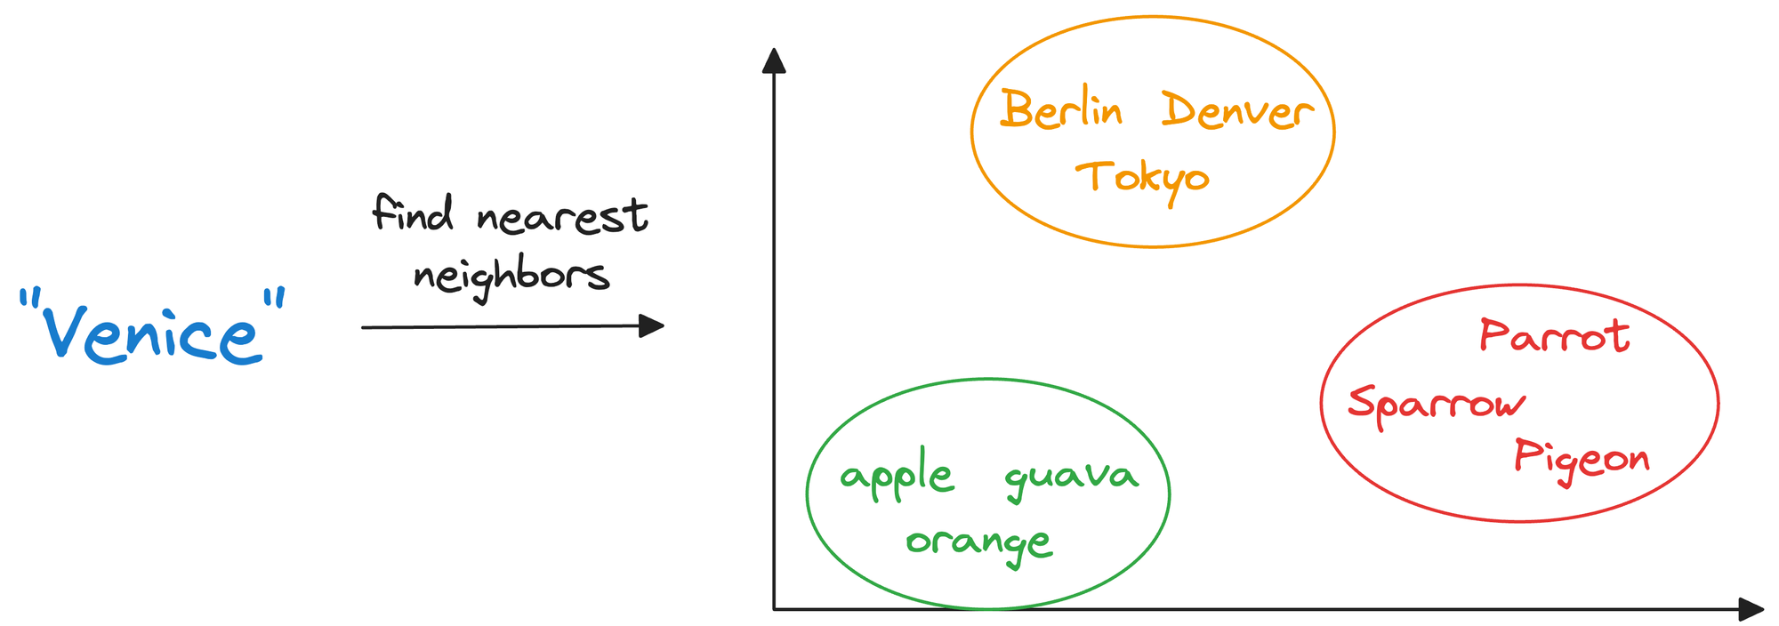
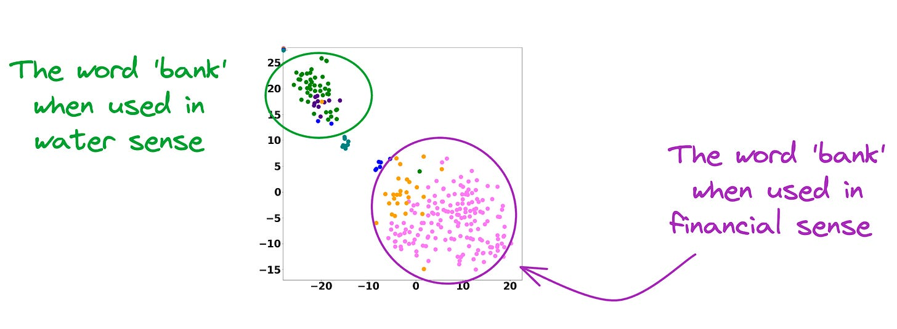
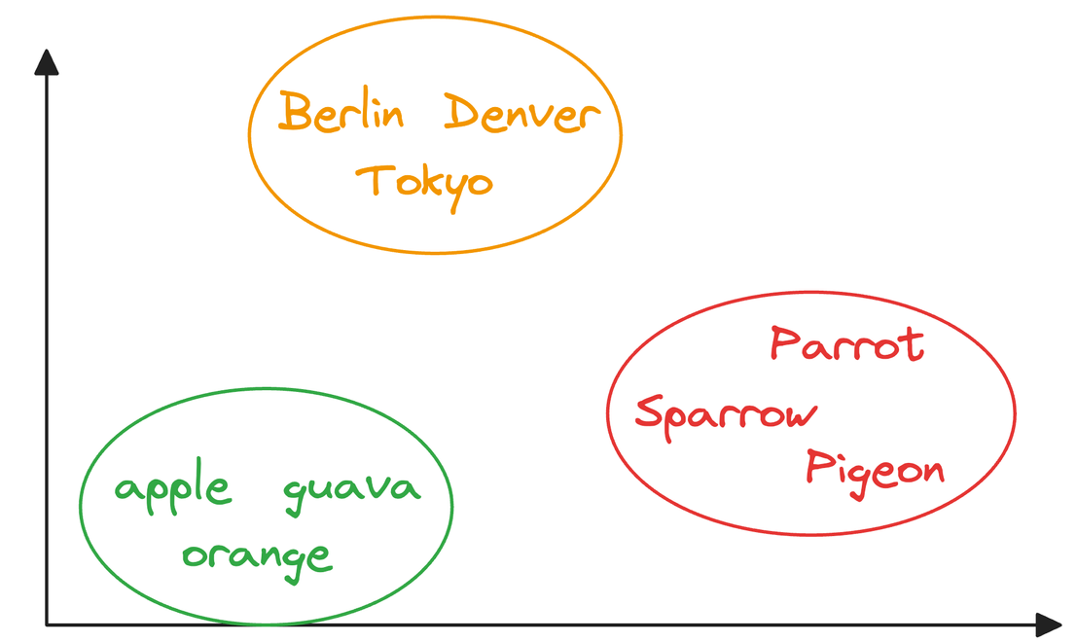
Backbone of RAG: Vector Databases
Creating a
Vector DB
At inference
Chunk and embed using an
embedding model
A vector database stores unstructured data,
in the form of vector embeddings
There are different methods by which similarity search is done
Why embedding works?
Important Note
Embeddings of similar meaning words
are near to each other→
Contextualized embedding models are used,
instead of static embedding models
Images source
Notes:
Use Chatgpt for images

Slide 21
LCM vs. RAG

Slide 22
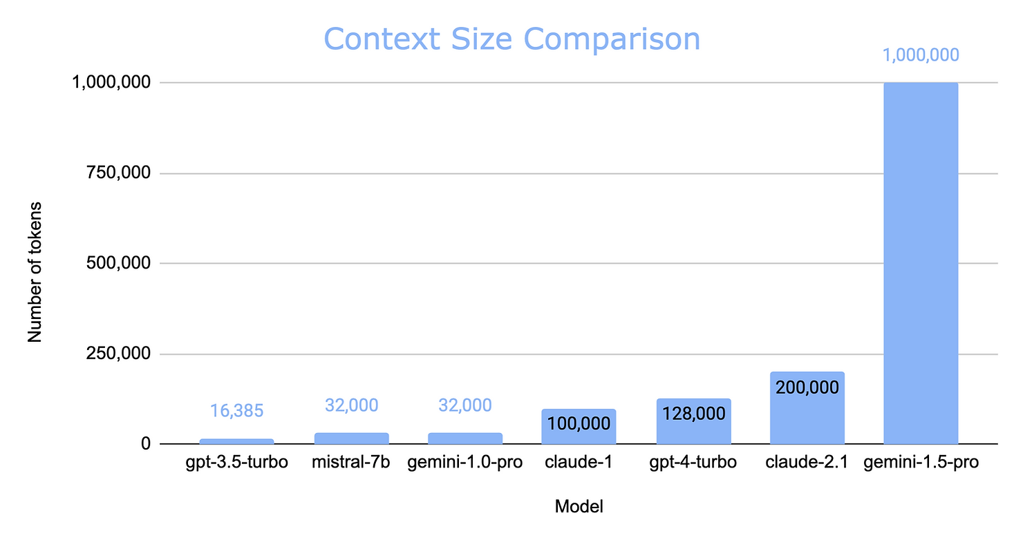
Increased Context Length – RAG still relevant?
Large Context Model
Source

Slide 23
Increased Context Length – RAG still relevant?
Cost: Large Context Models (LRAG winsCMs) like Gemini 1.5 are expensive per token, making RAG models more cost-effective for most use cases.!
Latency: LCMs take longer to process longer contexts. RAG models can achieve lower latency with smaller contexts. RAG wins!
Context Learning: LCMs excel at complex reasoning and learning from long contexts, demonstrated by reasoning about Apollo 11 transcripts and learning new skills. LCMs win!
Long Context Recall: LCMs may struggle with recalling information in the middle of long contexts. RAG models can curate relevant content before feeding it to the LLM. RAG wins!
Flexibility & Customization: RAG models offer more control over data sources and retrieval strategies, making them more customizable. LCMs are a faster solution but less flexible. RAG wins!
Security & Data Privacy: RAG models provide more control over data privacy, especially for self-hosted deployments. LCMs rely on an external provider's security measures. RAG wins!
Conclusion: RAG is here to stay!
Source

Slide 24
Improving RAG Systems

Slide 25
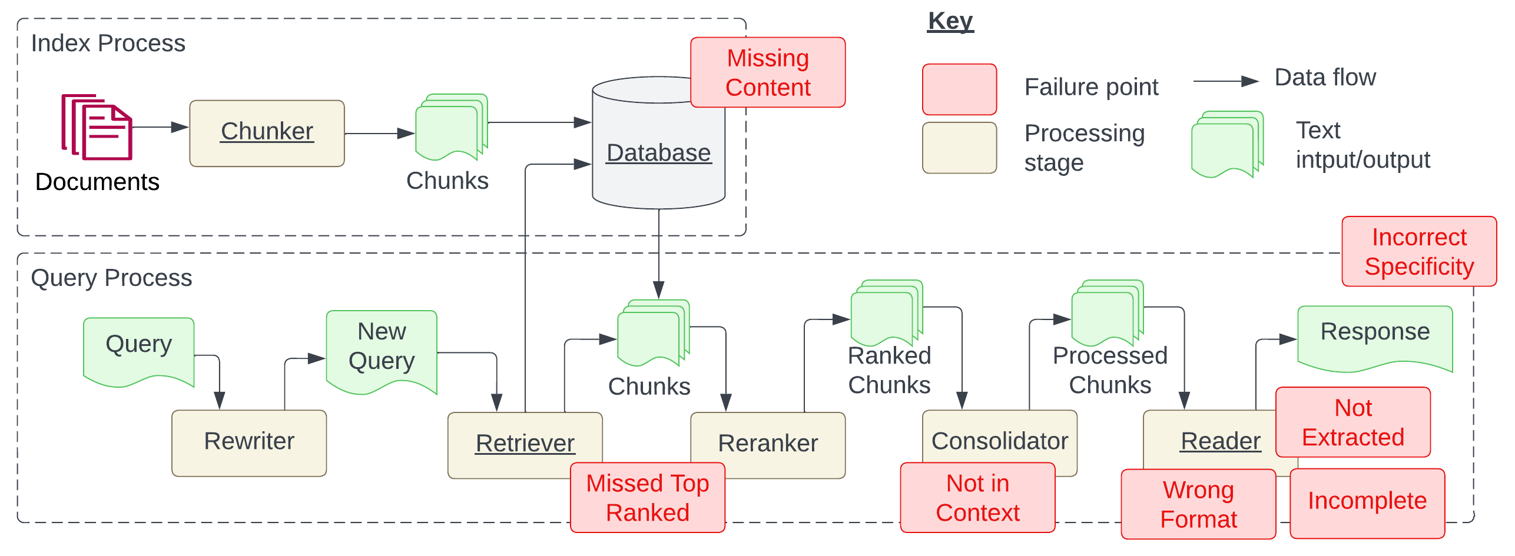
Key Failure Points of a RAG System
FP 1
Question is related to content, but there’s no information to answer
FP 6
Answer returned is too specific, or too vague
FP 4
LLM didn’t extract answer from context
FP 3
FP 5
FP 7
FP 2
Answer is available in document, but did not rank within the top K
Relevant documents with answer were retrieved, but didn’t make it to context
LLM ignored instruction regarding format
LLM returns incomplete answers, though information is in context
Source: Seven Failure Points When Engineering a RAG System (arXiv)
Notes:
Self-organizing maps
What are variational autoencoders

Slide 26
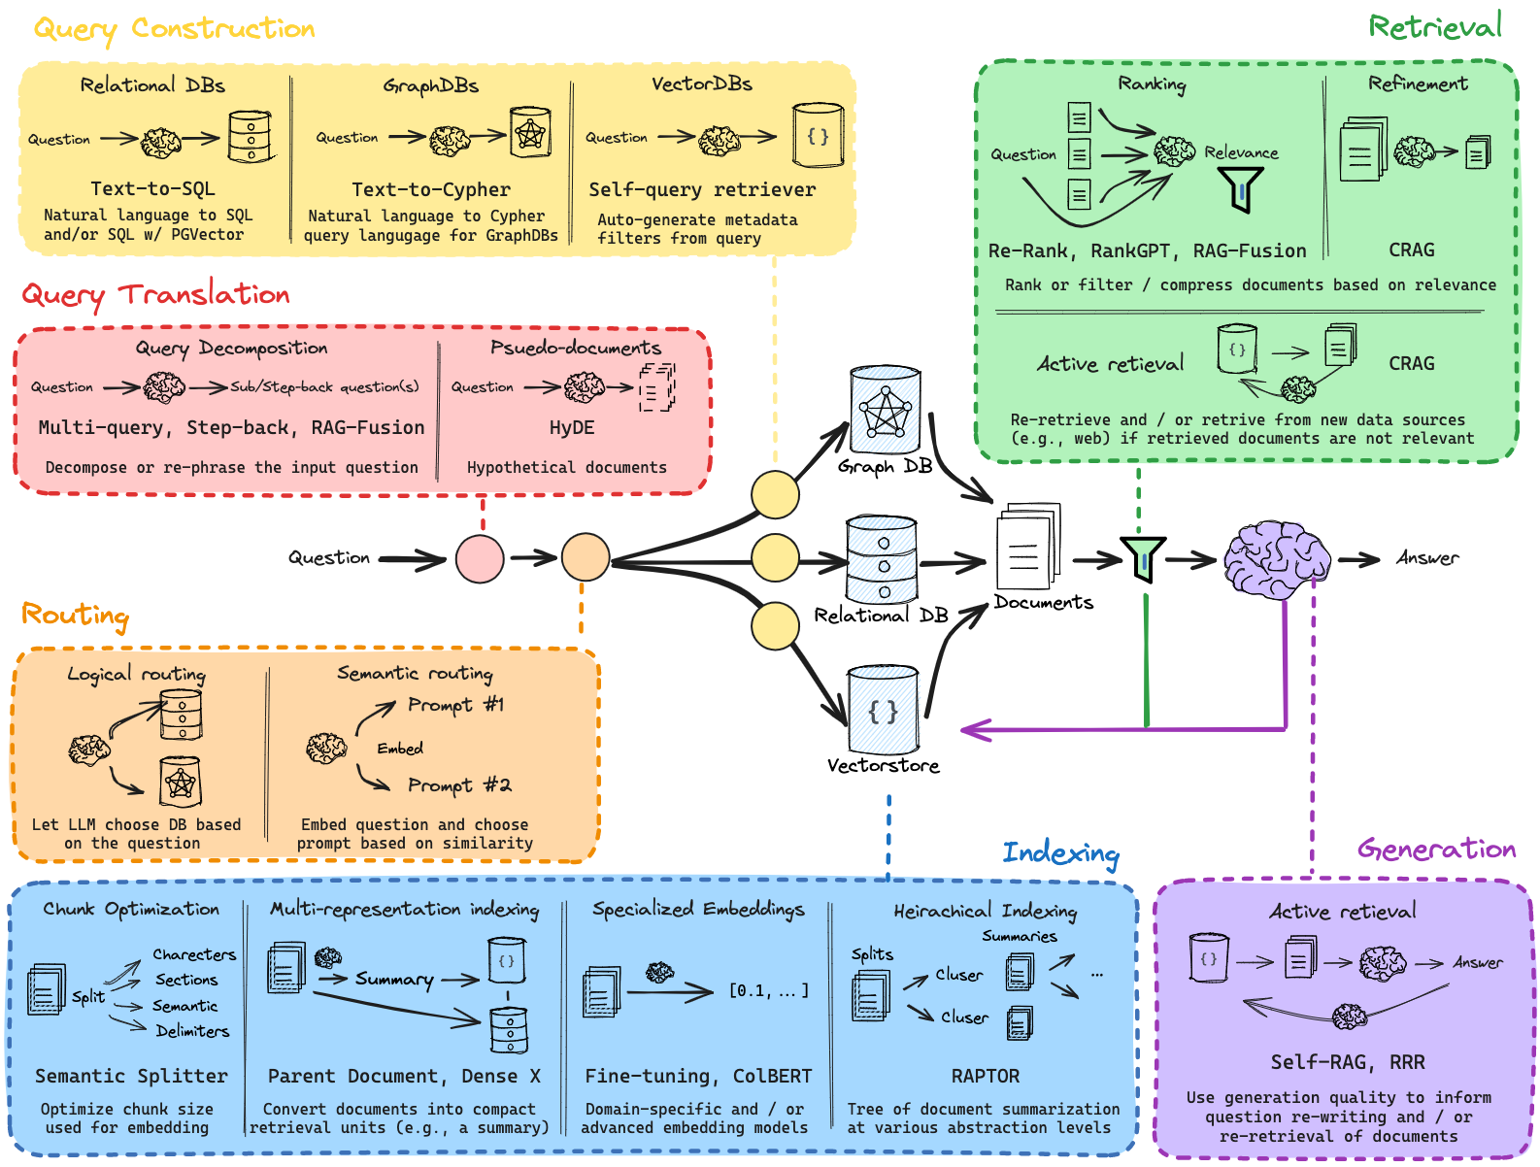
Methods to Improve RAG
Assuming prompts and choice of LLM are optimized for,
we’re optimizing for RAG!
Sourced from LangChain AI’s GitHub Repo here
Notes:
Self-organizing maps
What are variational autoencoders

Slide 27
Multimodal RAG

Slide 28
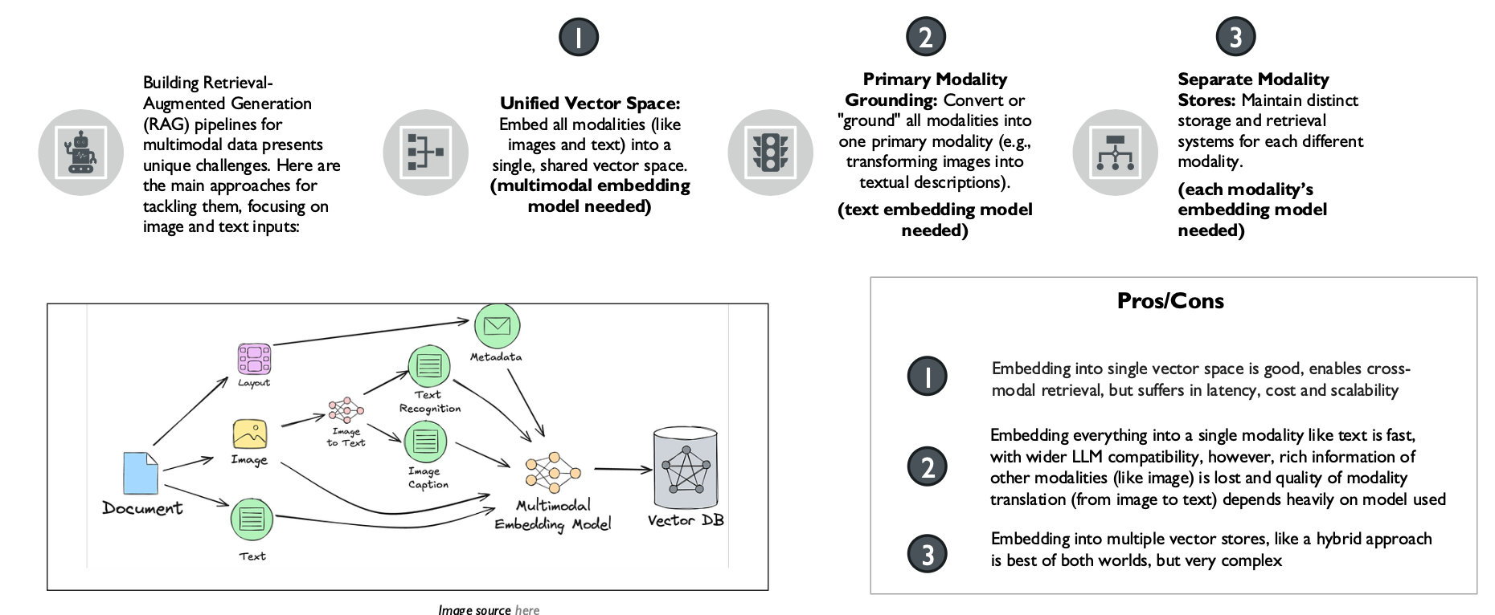
Multimodal RAG

Slide 29
Hands-on Tutorial

Slide 30
Assessment (14%)

Slide 31
Day 2: Building Agents with LangGraph
Notes:
Create an alternate journey slide that has the process for a platform team buyer persona
Get Numbers for the usage thing to Nikunj
In the pipeline things mention that the
Elevance – platform
Otsuka –business
Pfizer – Business Team
Medidata – both business and platform
Team slide, put team wise and some logo – only few people
Add G2 Review slide
Add Public Recognition
Elevance guy quote – Elevance thing This foundry is unlike any other foundry
Other Google review and all
Unique insights
GTM Slides pick from email
Long Term Direction Slide
Auto Pilot (Product Screenshots)
Competitors thing add
Product Deep dive explaining the product -> Modules -> One important slide and 3-4 follow up slides kinda thing
Fundraise slide – How much etc.
Ingest customer stories from throughout

Slide 32
Module 4: Building Agents with LangGraph

Slide 33
Why LLMs Alone Fall Short
LLMs can think, but not act
LLMs are limited by what’s available in their training data
There is a single inference basis the user query, and no continuous context management (i.e., chat history)

Slide 34
What We Need Instead
LLMs can think, but not act
Need to be able to to perform actions like making an API call
LLMs are limited by what’s available in their training data
Need to extend knowledge through connection with external systems such as search tools
There is a single inference basis the user query, and no continuous context management (i.e., chat history)
Need to have a managed session history, which allows for multi-turn conversations

Slide 35
The Augmented LLM
The basic idea is to augment the LLM with retrieval, tools and memory, where they can generate their own search queries, select appropriate tools and determine what information to retain.
User Prompt
LLM
Output
Query/Results
Read/Write
Call/Response
Retrieval
Memory
Tools
The Augmented LLM

Slide 36
Agents vs. Workflows
Workflows are systems where LLMs and tools are orchestrated through predefined code paths
Agents are dynamic systems where LLMs direct their own processes and tool usage, maintaining control over how they accomplish tasks (i.e., LLM controls execution logic)
Both are characterized as “Agentic AI systems”, however the architectural difference exists!
Capability | Workflow | Agent
Augmented LLMs | Yes | Yes
Control Flow | Fixed, pre-defined | Dynamic
Costs | Predictable | More unpredictable

Slide 37
Agentic AI: Workflows

Slide 38
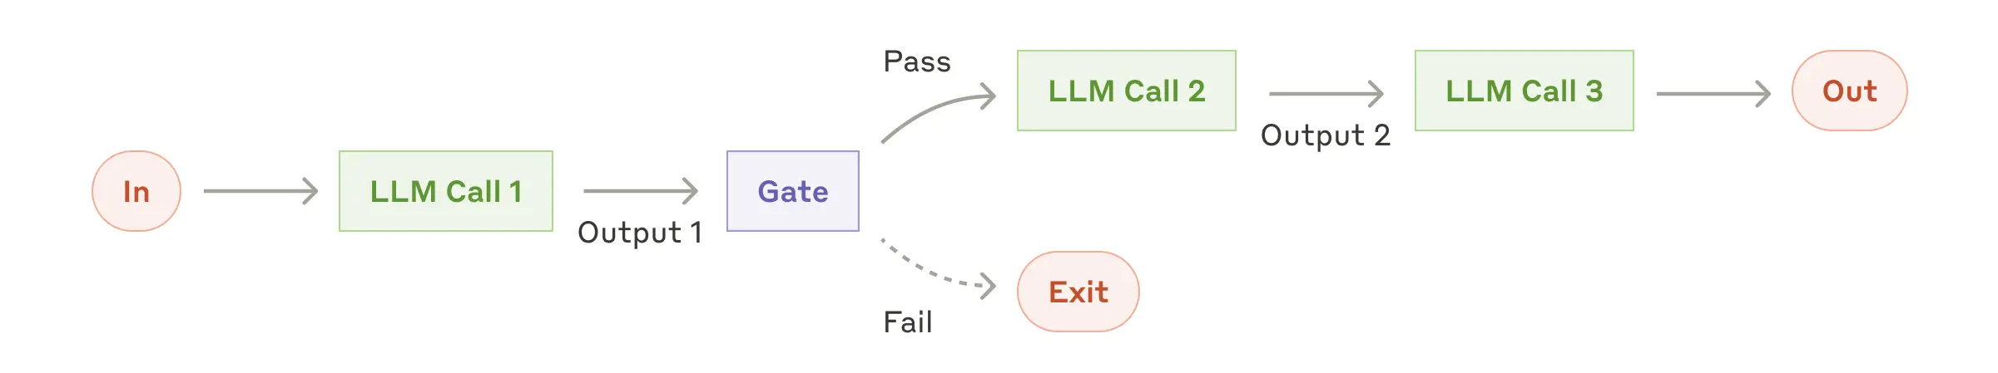
Workflow: Prompt Chaining
Goal: Decompose into fixed sub-tasks; any programmatic checks can be added to ensure process is on track
When to Use: Where task can be easily and cleanly decomposed into fixed subtasks
Use Cases:
Generate marketing copy, then translate to different languages
Write outline of document, check if it meets specific criteria, then write document
Reference: Anthropic

Slide 39
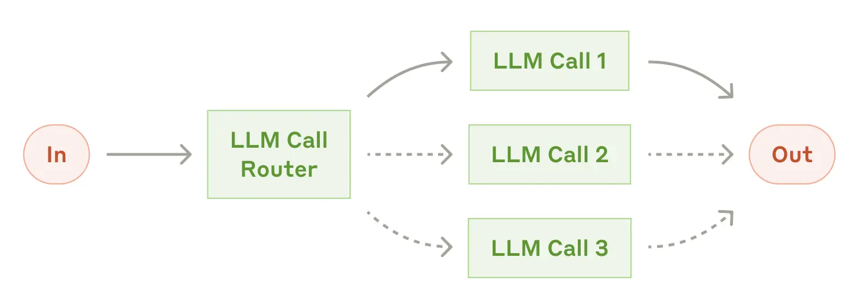
Workflow: Routing
Goal: Direct an input into a specialized sub-task, ensuring separation of concerns
When to Use: Where distinct categories of tasks are better handled separately, and category classification is easy
Use Cases:
Directing customer service queries (general questions, refund requests, technical support)
Routing questions based on complexity to smaller/more capable models, to optimize cost and speed
Reference: Anthropic

Slide 40
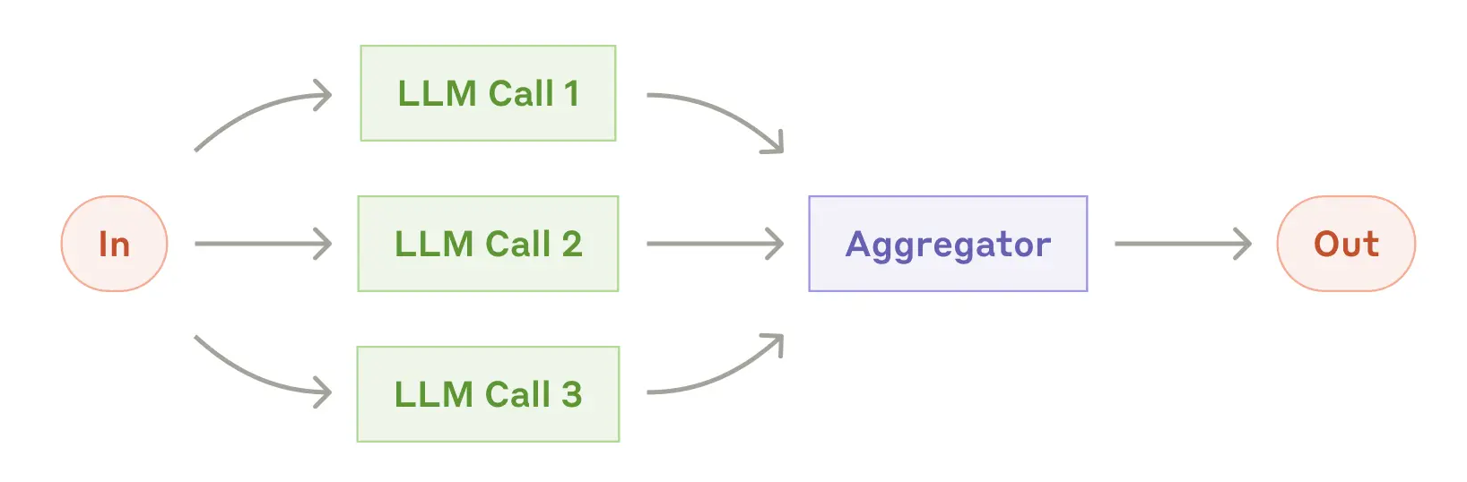
Workflow: Parallelization (Sectioning)
Goal: Breaking down into different tasks and running multiple subtasks concurrently, post which aggregation is done.
When to Use: Where complex tasks can be broken down and parallelized for speed
Use Cases:
Guardrails, where one model instance processes user query and another screens for inappropriate requests
Automating evals, where each LLM call evaluates a different aspect of performance
Reference: Anthropic

Slide 41
Workflow: Parallelization (Voting)
Goal: Running same task multiple times concurrently to get diverse outputs, post which voting is done
When to Use: Where higher confidence in the output is needed
Use Cases:
Reviewing a piece of code for vulnerabilities
Evaluating whether a given piece of content is inappropriate, with different thresholds to balance false positives and negatives.
Reference: Anthropic

Slide 42
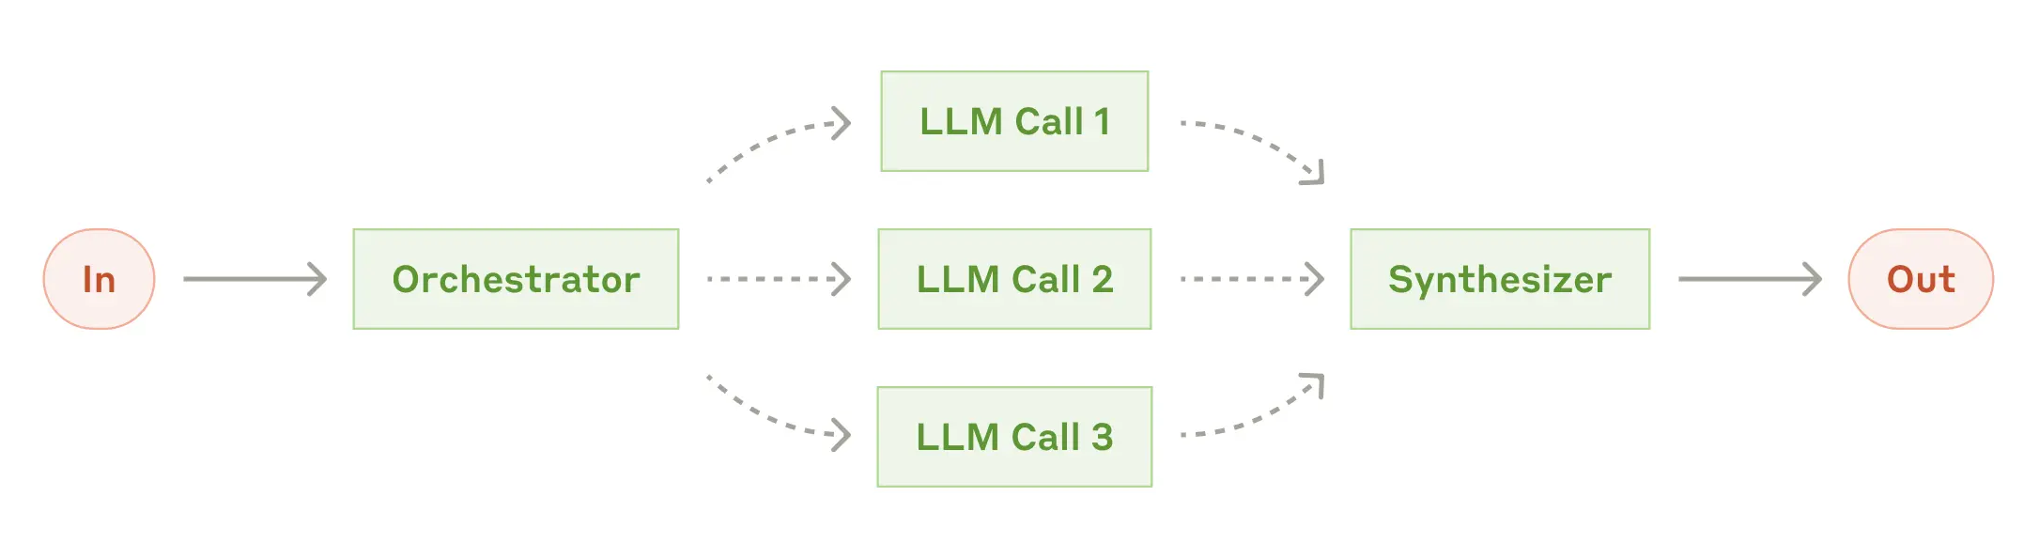
Workflow: Orchestrator-Worker
Goal: Complex tasks are broken down dynamically and combined
When to Use: Where subtasks can’t be predicted, but need to be determined (also allows for more flexibility)
Use Cases:
Search tasks that involve gathering and analyzing information from many sources
Reference: Anthropic

Slide 43
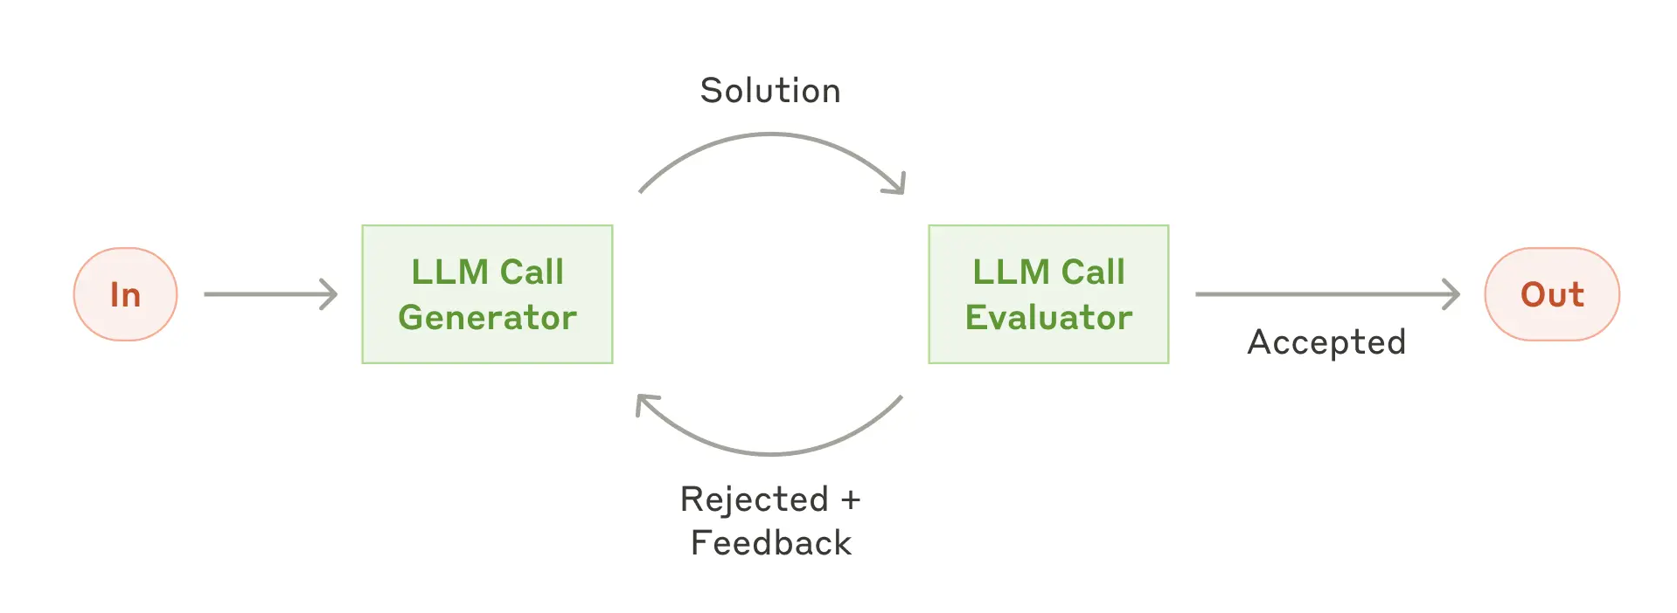
Workflow: Evaluator-Optimizer
Goal: LLM output is validated by another
When to Use: Where 1) LLM responses can be clearly evaluated (via criteria), 2) human feedback significantly improves LLM responses iteratively, and 3) whether LLM can provide such feedbacks
Use Cases:
Literary translation, where translator LLM responses can be improved with evaluator LLM’s critiques
Complex search tasks where evaluator decides whether further searches are needed
Reference: Anthropic

Slide 44
Agentic AI: Agents

Slide 45
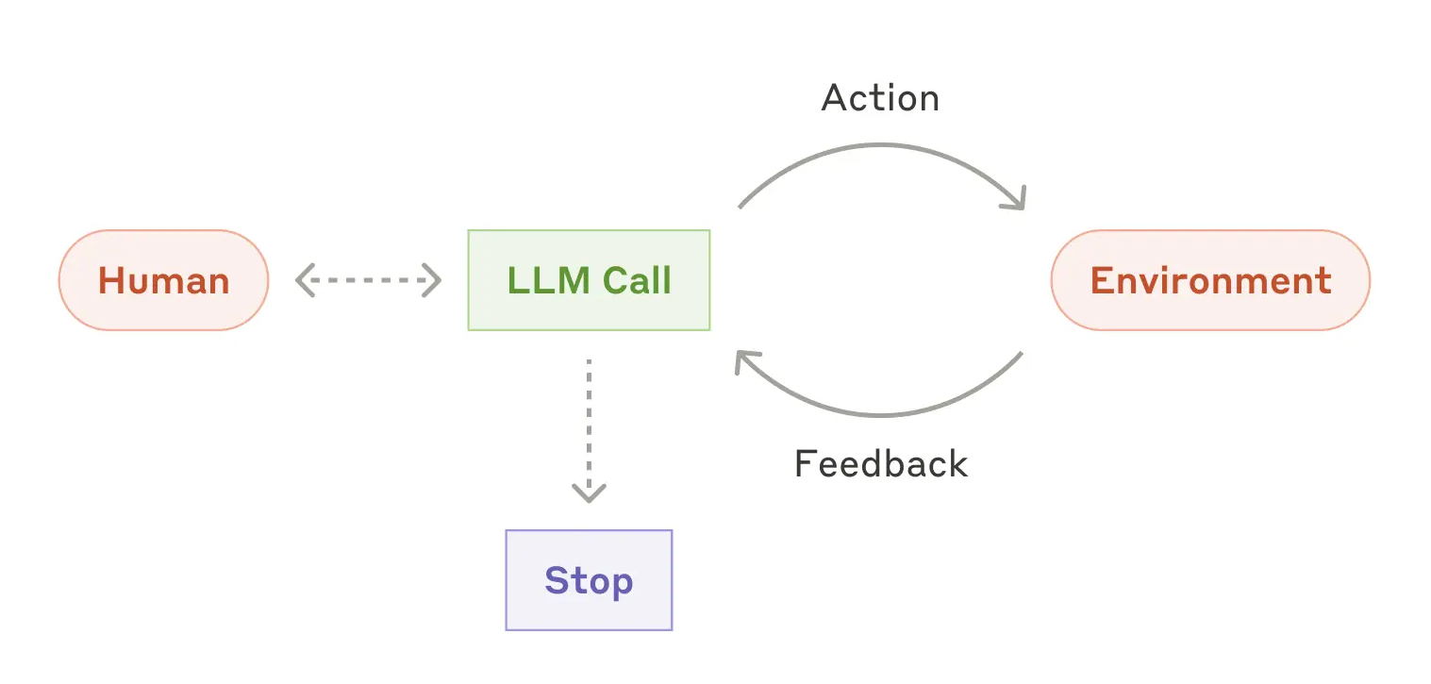
In contrast, Agents -
Goal: With more advanced LLM capabilities (understanding complex inputs, engaging in reasoning and planning, using tools reliably, and recovering from errors), plan and operate independently while returning to human for feedback
When to Use: For open-ended problems, where it’s difficult to predict required number of steps or find a fixed path
Many Use Cases (complex)
Customer support (talk, pull data, act, resolve)
Coding agents (design, build, test, measure)
Reference - Anthropic

Slide 46
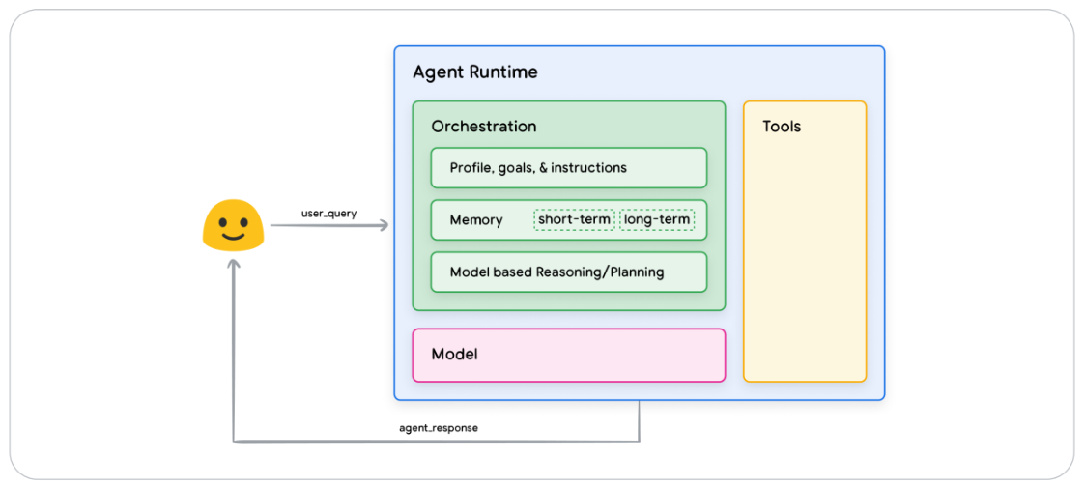
What constitutes an AI Agent
Agents are AI systems that leverage LLMs to reason through a solution, leveraging external tools, planning (like reflection and task decomposition), and having memory (short-term or long-term).
Source: Google’s Agents Whitepaper

Slide 47
Deeper into Tools

Slide 48
Tools and Function Calling
Function calling in Large Language Models (LLMs) enables these models to interact with external tools and APIs, thereby extending their capabilities beyond text generation to include real-time data retrieval

Slide 49
Tools and Function Calling
The function-calling feature is implemented using a combination of fine-tuning, prompt engineering, and structured output generation techniques.
Finetuning: Teach the LLM to call functions, by showing it examples of user query – correct function
Prompt Engineering: Include the function's name, a description of what it does, and a list of its required parameters and their data types
Structured Output Generation: LLM should generate a structured output, typically a JSON, containing the function’s name and specific arguments needed
Note: Prompt engineering tools is as important as overall prompt engineering, as agents often fail at their tasks when they don’t call tools the right way!

Slide 50
Tools and Function Calling
Primary use cases that leverage function calling:
Agents
For example, if you say, "What's the weather like in Boston?", the LLM can decide that it needs a weather API to get the answer. It then generates a structured function call (e.g., get_weather(location="Boston")), which your application executes. The results from that API are then sent back to the LLM, which uses them to formulate a natural language response like, "The weather in Boston is currently sunny and 75°F.”
Complex multi-turn chatbots
By using function calls, the chatbot can "write" to a memory or database and "read" from it in subsequent turns.
Batch inference feature extraction
For example, you could have millions of customer reviews and use an LLM with a function-calling capability to extract key information like product_name, sentiment (positive/negative), and key_complaint.
Structured output generation
In general!

Slide 51
Tools and Function Calling
Not all LLMs are made the same, and LLMs differ in their capabilities to call the right tools
Berkeley Function-Calling Leaderboard

Slide 52
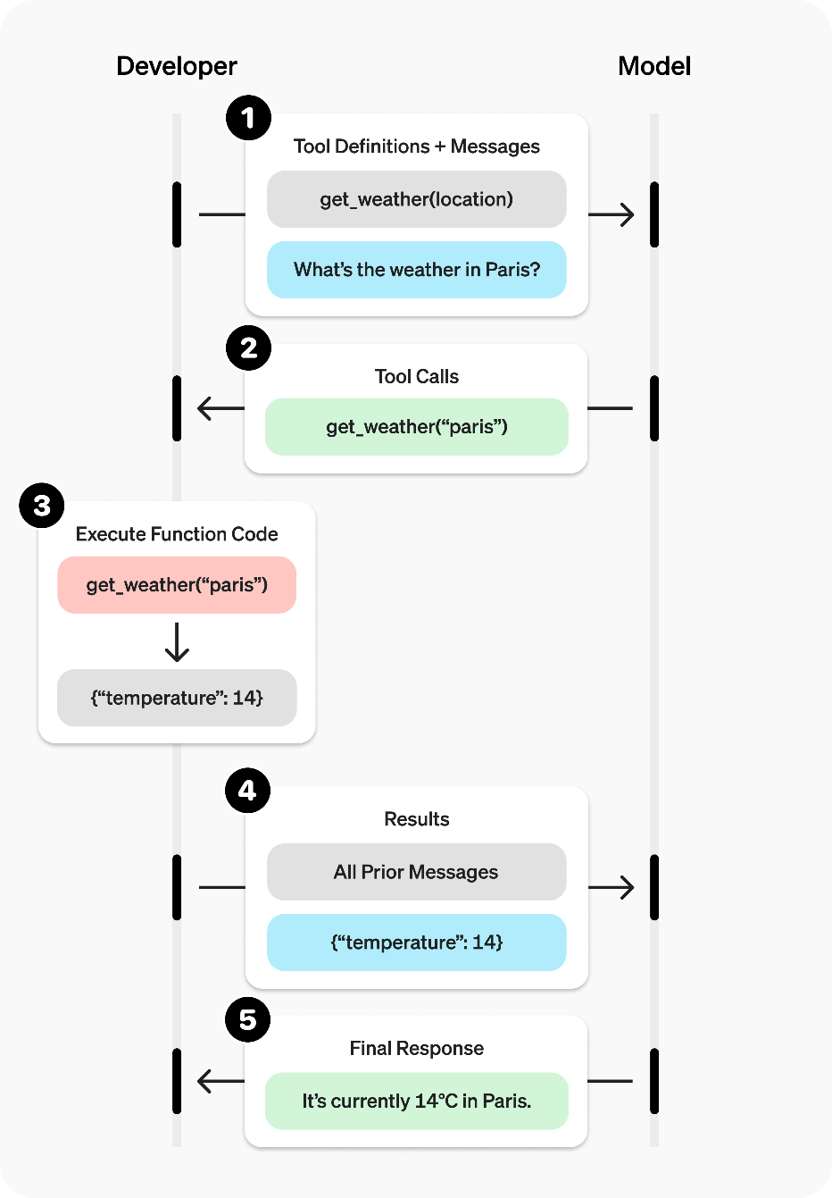
Tools and Function Calling
How the Execution Happens
Image Source: OpenAI

Slide 53
Agentic Design Patterns

Slide 54
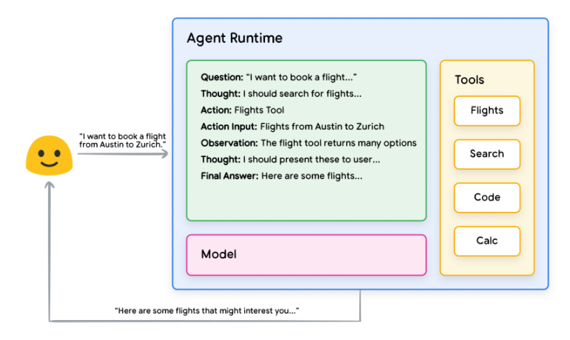
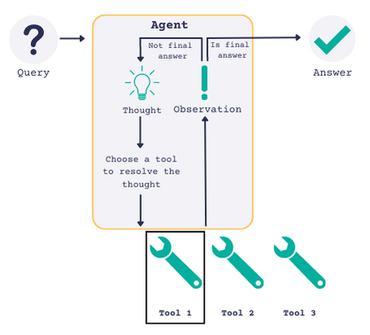
The Simplest Form of Agent: ReACT Agent
The ReAct (Reasoning and Action) agent model
Integrates the reasoning capabilities of large language models (LLMs) with the ability to take actionable steps
Creates a more sophisticated system that can understand and process information
Can evaluate situations, take appropriate actions, communicate responses, and track ongoing situations.
ReAct: Synergizing Reasoning and Acting in Language Models

Slide 55
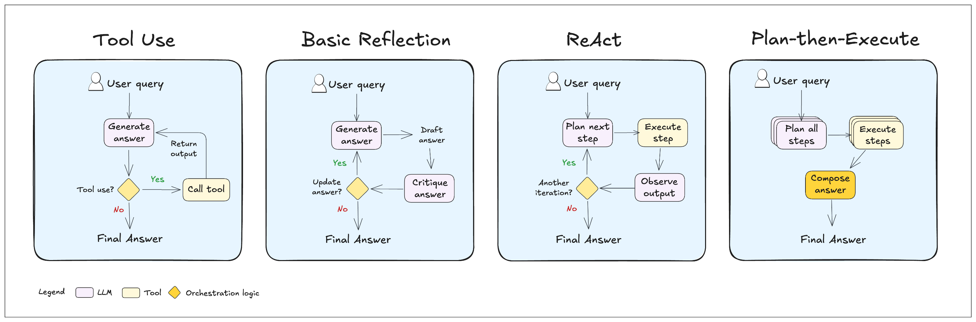
Some Single-Agent Design Patterns
Image Source

Slide 56
When Single-Agent Systems Fall Short
Overloaded Agents: A single agent can struggle to make good decisions when it has access to too many tools, leading to poor performance.
Complex Context: A single agent can have difficulty managing a large or complex conversational context, causing it to lose track of the user's request.
Lack of Specialization: A single agent isn't equipped to handle a wide range of tasks that require different skills, like planning, research, and mathematical expertise.

Slide 57
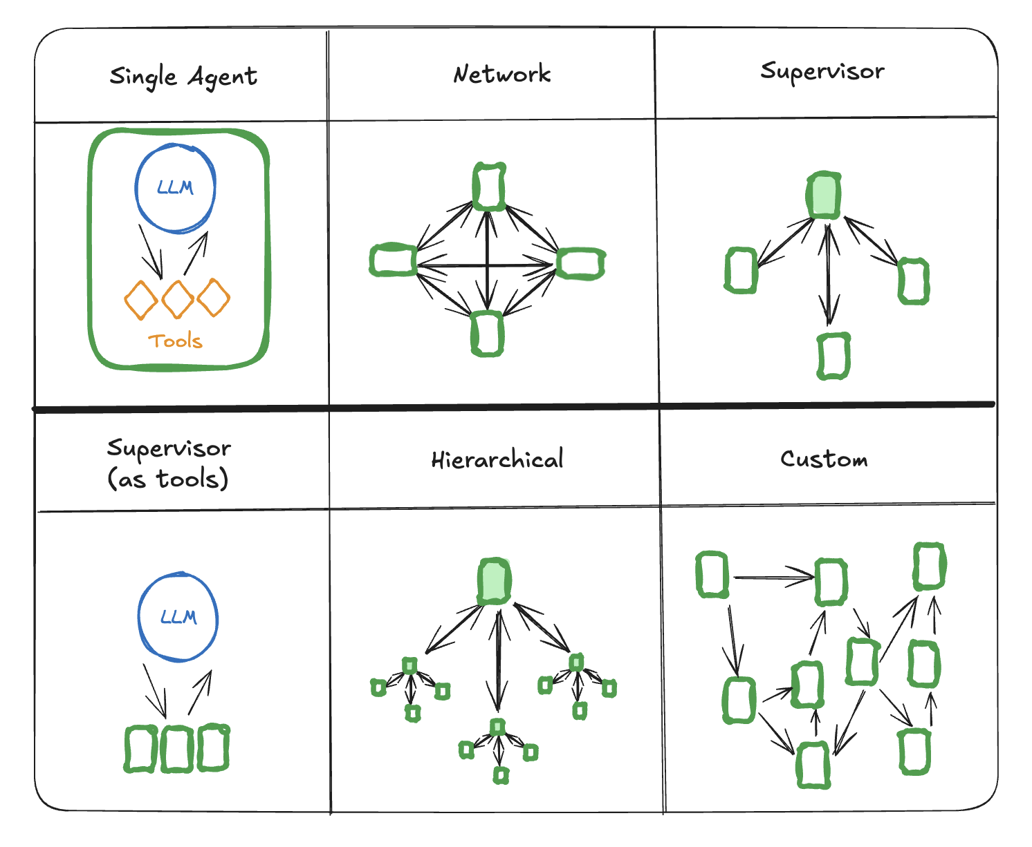
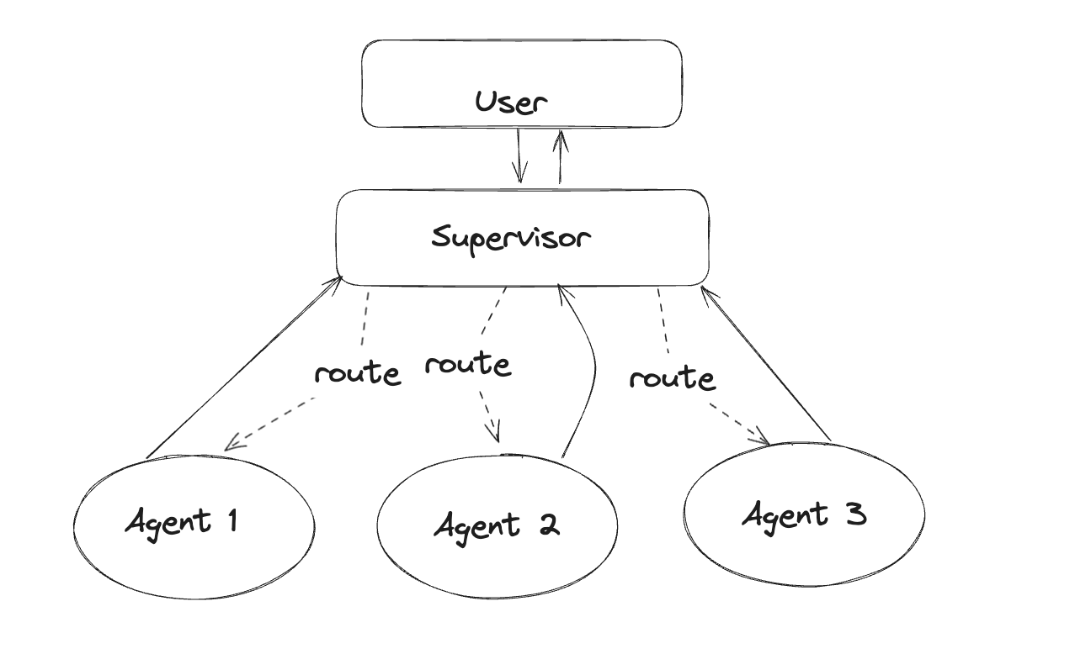
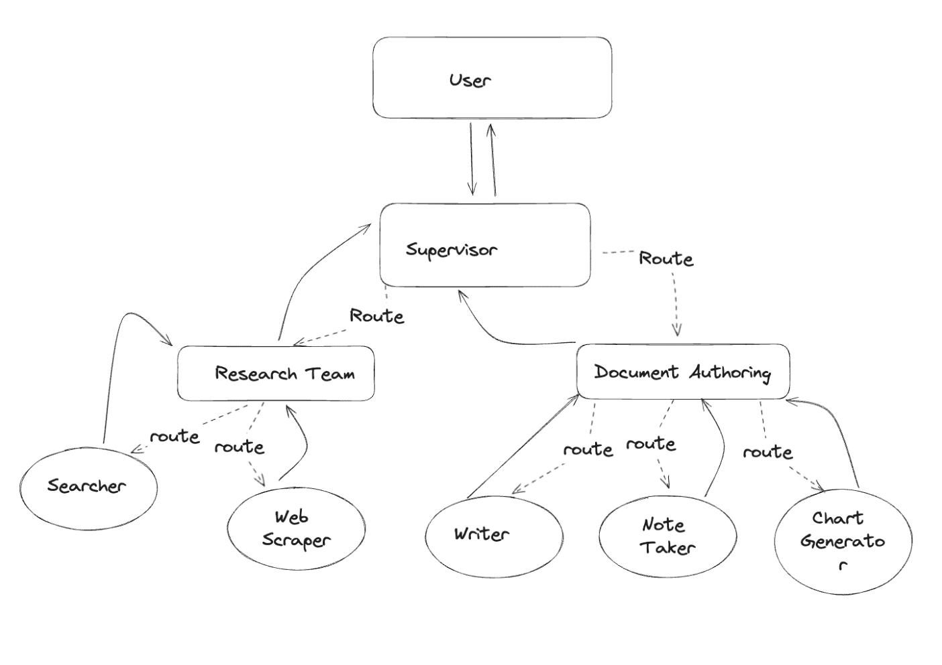
Multi-Agent Design Patterns
Reference - LangChain

Slide 58
Guidelines and Considerations

Slide 59
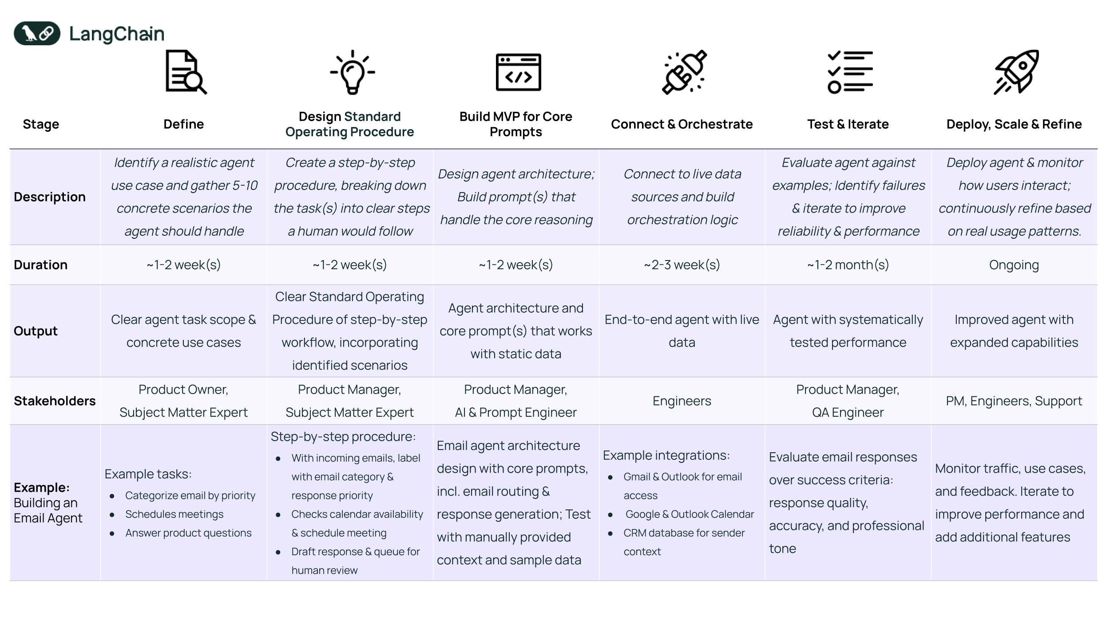
General Guidelines for Building Agents
Reference - LangChain

Slide 60
Considerations When Building Agents
Risks
Unpredictable path
Unpredictable output
Unpredictable costs
The Need to Monitor
Guardrails: they ensure agents behave safely, consistently and within intended boundaries
Cost, Latency, Tracing etc.
Enter AI Gateway as a one-stop solution!
Recommendation
Build the right system, not always the most sophisticated one
Start with simple prompts, optimize with evaluation, then go to multi-step agentic systems
Reference - Anthropic

Slide 61
Comparison of Popular Agentic AI Frameworks
Choose LangGraph if: You need precise control over complex, looping workflows and robust state management for production.
Choose CrewAI if: You want to model collaborative teams of AI agents with distinct roles and intuitive interaction.
Choose AutoGen if: You need highly flexible agent conversations, especially for code-centric problem-solving and iterative tasks.
Feature/Framework | LangGraph | CrewAI | AutoGen
Core Idea | Graph-based workflows, powerful state management for complex cycles. | Role-based multi-agent systems for intuitive collaboration. | Flexible conversation patterns and agent topologies.
Best For | Complex, cyclical processes; human-in-the-loop; production-ready applications. | Team-based workflows; automated customer support, research, or development. | Complex problem-solving; code generation & debugging; diverse agent interactions.
Key Strength | Superior state control & flow; highly customizable; production-grade. | Intuitive collaborative intelligence; clear role delegation. | Flexible conversational dynamics; strong code execution & debugging.
Learning Curve | Steeper (graphs & state) | Medium | Medium
Scalability | High (built for production) | Medium-High | Medium-High
Tooling | Strong via LangChain | Flexible custom tools | Strong (code execution, APIs)

Slide 62
Hands-on Tutorial

Slide 63
Assessment (14%)

Slide 64
Day 3: Agents (cont.) and Model Context Protocol
Notes:
Create an alternate journey slide that has the process for a platform team buyer persona
Get Numbers for the usage thing to Nikunj
In the pipeline things mention that the
Elevance – platform
Otsuka –business
Pfizer – Business Team
Medidata – both business and platform
Team slide, put team wise and some logo – only few people
Add G2 Review slide
Add Public Recognition
Elevance guy quote – Elevance thing This foundry is unlike any other foundry
Other Google review and all
Unique insights
GTM Slides pick from email
Long Term Direction Slide
Auto Pilot (Product Screenshots)
Competitors thing add
Product Deep dive explaining the product -> Modules -> One important slide and 3-4 follow up slides kinda thing
Fundraise slide – How much etc.
Ingest customer stories from throughout

Slide 65
Module 5: Agentic RAG

Slide 66
Hands-on Tutorial

Slide 67
Module 6: Model Context Protocol

Slide 68
Pre-MCP Context Management
This was a set of one-off solutions that required extensive engineering, and wasn’t completely proactive from the model’s side.
Truncation and Sliding Windows
Summarization
Template-based prompts
Context management
Static Prompting (pre-tools)
RAG
Prompt chaining and agents
Function calling mechanisms
External context
enhancement
Model either knew something or didn’t
Model doesn’t initiate lookups/developer puts the logic in
Integrating new tools, meant custom prompt logic and parsing
See MxN integration problem

Slide 69
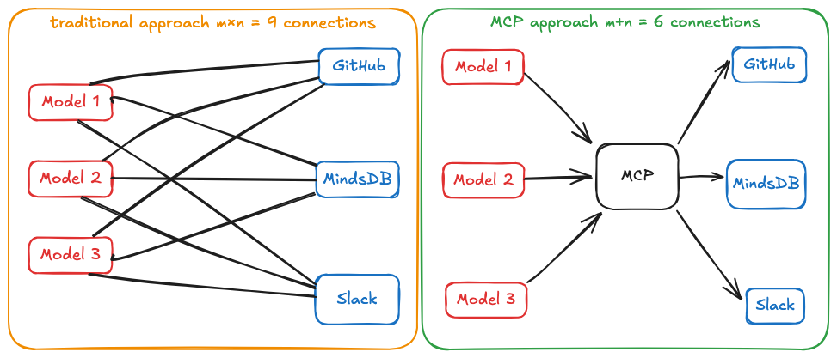
MxN Integration Problem
Source

Slide 70
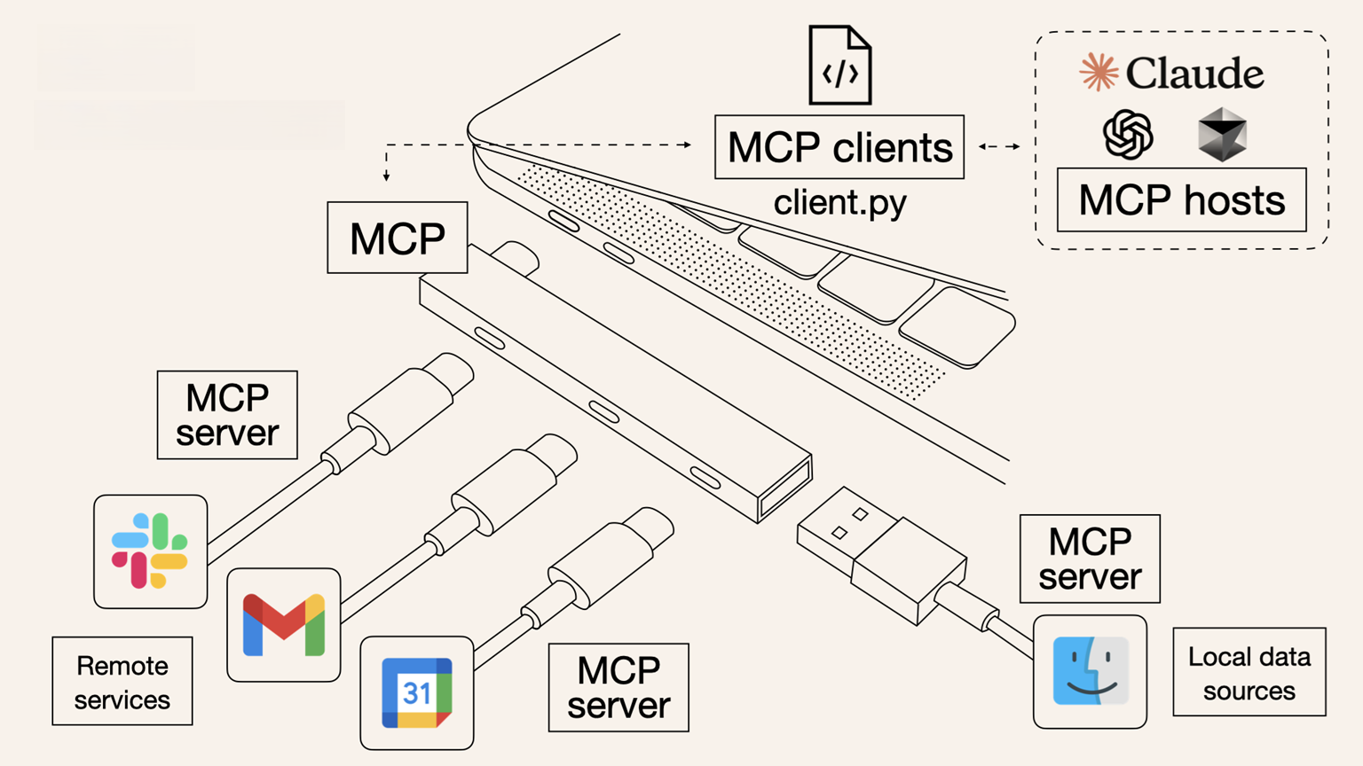
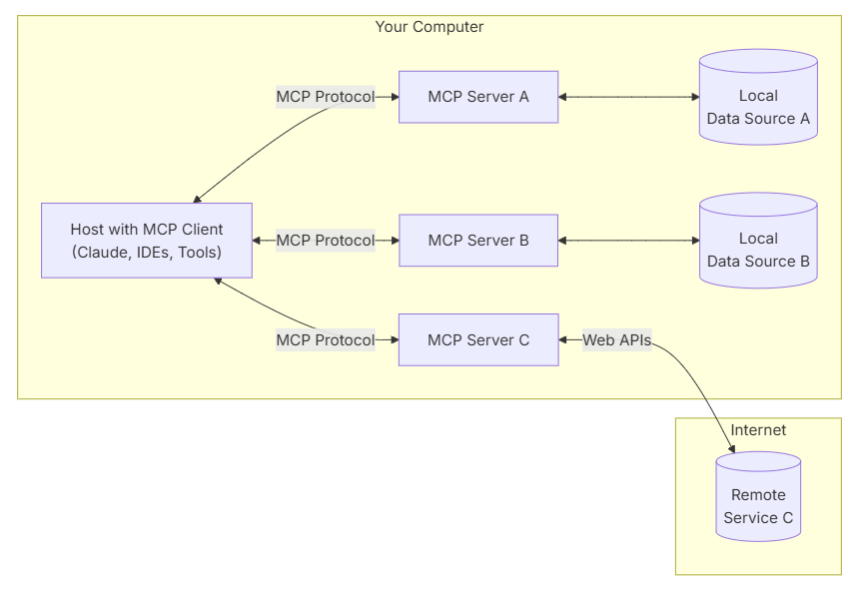
Model Context Protocol (MCP)
MCP is an open protocol that standardizes how applications provide context to LLMs.
Single protocol: MCP acts as a standardized "connector," so integrating one MCP means potential access to multiple tools and services, not just one
Dynamic discovery: MCP allows AI models to dynamically discover and interact with available tools without hard-coded knowledge of each integration
Two-way communication: MCP supports persistent, real-time two-way communication. The AI model can both retrieve information and trigger actions dynamically

Slide 71
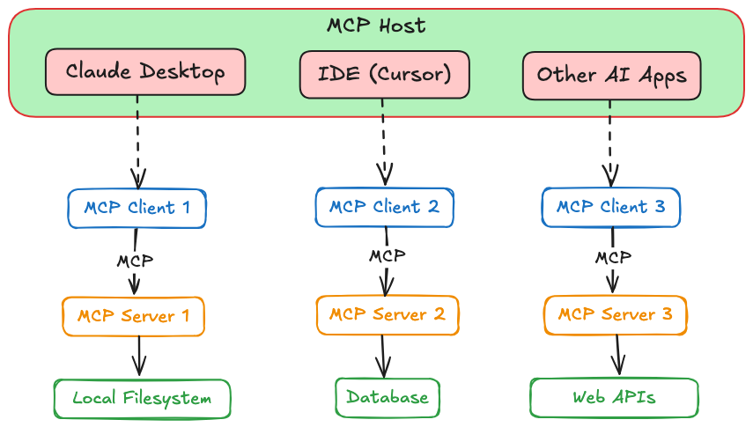
Architecture
MCP (Model Context Protocol) uses a client-server architecture to connect AI models with external resources, built on three key components: the Host, Clients, and Servers.
The Host is the AI application or agent the user interacts with (e.g., a desktop app, IDE plugin, or custom LLM app). It can simultaneously connect to multiple MCP Servers.
An MCP Client acts as an intermediary, managing each server connection. Each client handles communication with a single MCP Server, providing security isolation. The Host spawns one client per server, creating a dedicated, one-to-one link.
The MCP Server is an external program implementing the MCP standard. It offers specific capabilities, including tools, data access, and domain-related prompts. Servers can interface with databases, cloud services, and other data sources, with existing examples for Google Drive, Slack, GitHub, various databases, and web browsers.
Source Image

Slide 72
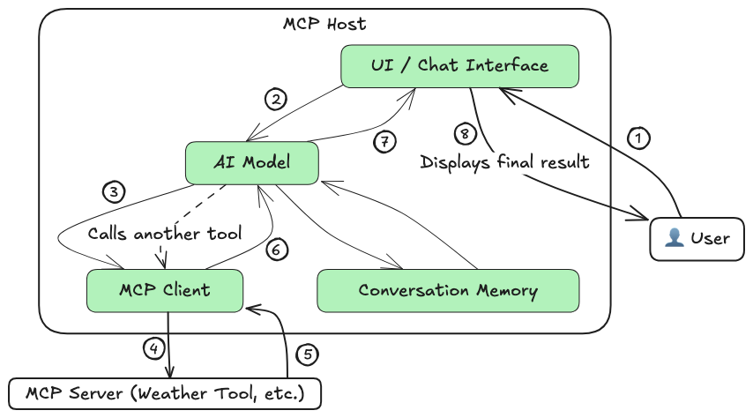
How it Works
Capability Discovery: The MCP client fetches the list of available tools/resources from the server and shares it with the AI model.
Augmented Prompting: The user's query is sent to the model along with descriptions of the server's tools/resources, enabling the model to understand what external actions are possible.
Tool/Resource Selection: The model decides if an external tool is needed and responds with a structured request (per MCP spec) indicating the desired tool (e.g., “Weather API”).
Server Execution: The client invokes the requested tool on the MCP server, which performs the action (e.g., API call or database query) and returns the result.
Response Generation: The model receives the result, integrates it with its own knowledge, and generates a final, enriched response for the user.
Source Image

Slide 73
MCP vs. RAG and Vector Search
RAG appends retrieved documents directly into prompts as raw text — useful but unstructured.
MCP offers structured context management: retrieved data is slotted into labeled Resource blocks (e.g., “Retrieved Documents”), keeping different types of information organized.
You can combine RAG with MCP: fetch via vector search, then pass results as structured context — easier to manage, update, and debug.

Slide 74
MCP vs. Monolithic Prompts and Finetuning
Traditional methods relied on:
Monolithic prompts – bulky, hard to edit, expensive (token-wise).
Fine-tuning – slow, costly, hard to adapt on the fly.
MCP enables modular prompting:
Define reusable context layers (e.g., “Policy Guidelines”, “User History”).
Update individual layers without rewriting or retraining.
Saves time and tokens while improving flexibility and maintainability.

Slide 75
MCP vs. Function Calling and Plugins
Function calling/tools in LLMs (like OpenAI plugins) are powerful but fragmented — each provider has its own setup.
MCP standardizes tool use across models with unified Tool, Prompt, and Resource primitives.
Interoperable & extensible:
Write once, work across providers (e.g., OpenAI, Claude, Llama).
Covers non-functional context needs (like guidance, templates) beyond API calls.

Slide 76
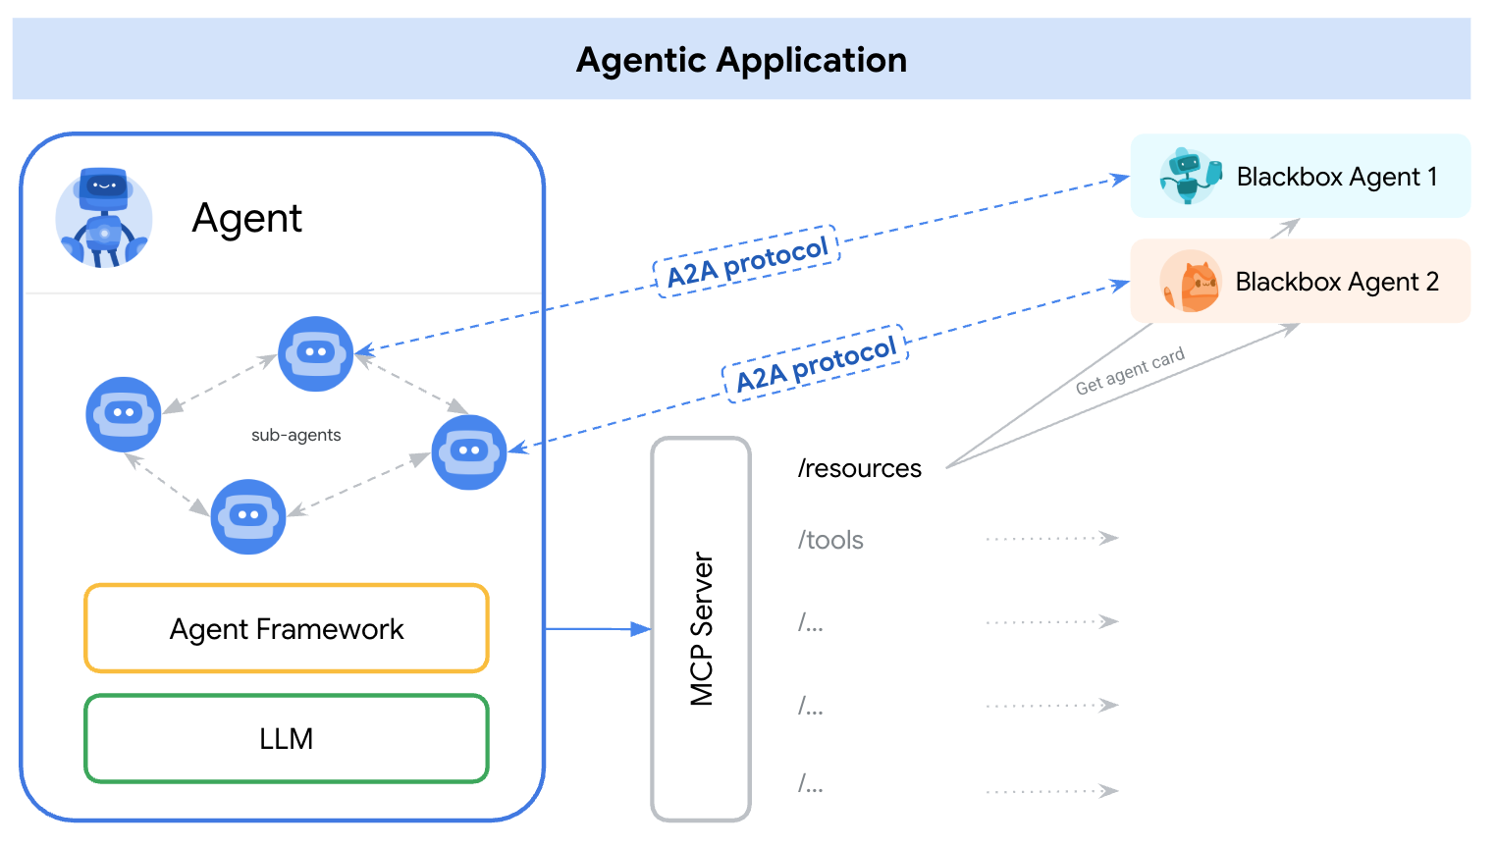
MCP vs. A2A
A2A and MCP are both complementary protocols
Feature | Agent2Agent Protocol (A2A) | Model Context Protocol (MCP)
Interaction | Between agents (from different frameworks also!) | Between agent and tools
Use Case | Delegating tasks to other agents | Enhancing context with external data
Dependency | Relies on other agents | Relies on tool integrations
Architecture | Multi-agent system | Tool-augmented single-agent system
MCP and A2A Integration
By representing A2A agents as MCP resources—encapsulated within their AgentCards—AI applications facilitate dynamic agent discovery.
This allows agents on an MCP server to connect and collaborate via the A2A protocol.
Inage source here

Slide 77
Basics of FastMCP and CrewAI

Slide 78
Important Links for FastMCP
https://gofastmcp.com/tutorials/mcp
https://gofastmcp.com/tutorials/create-mcp-server
https://gofastmcp.com/getting-started/quickstart

Slide 79
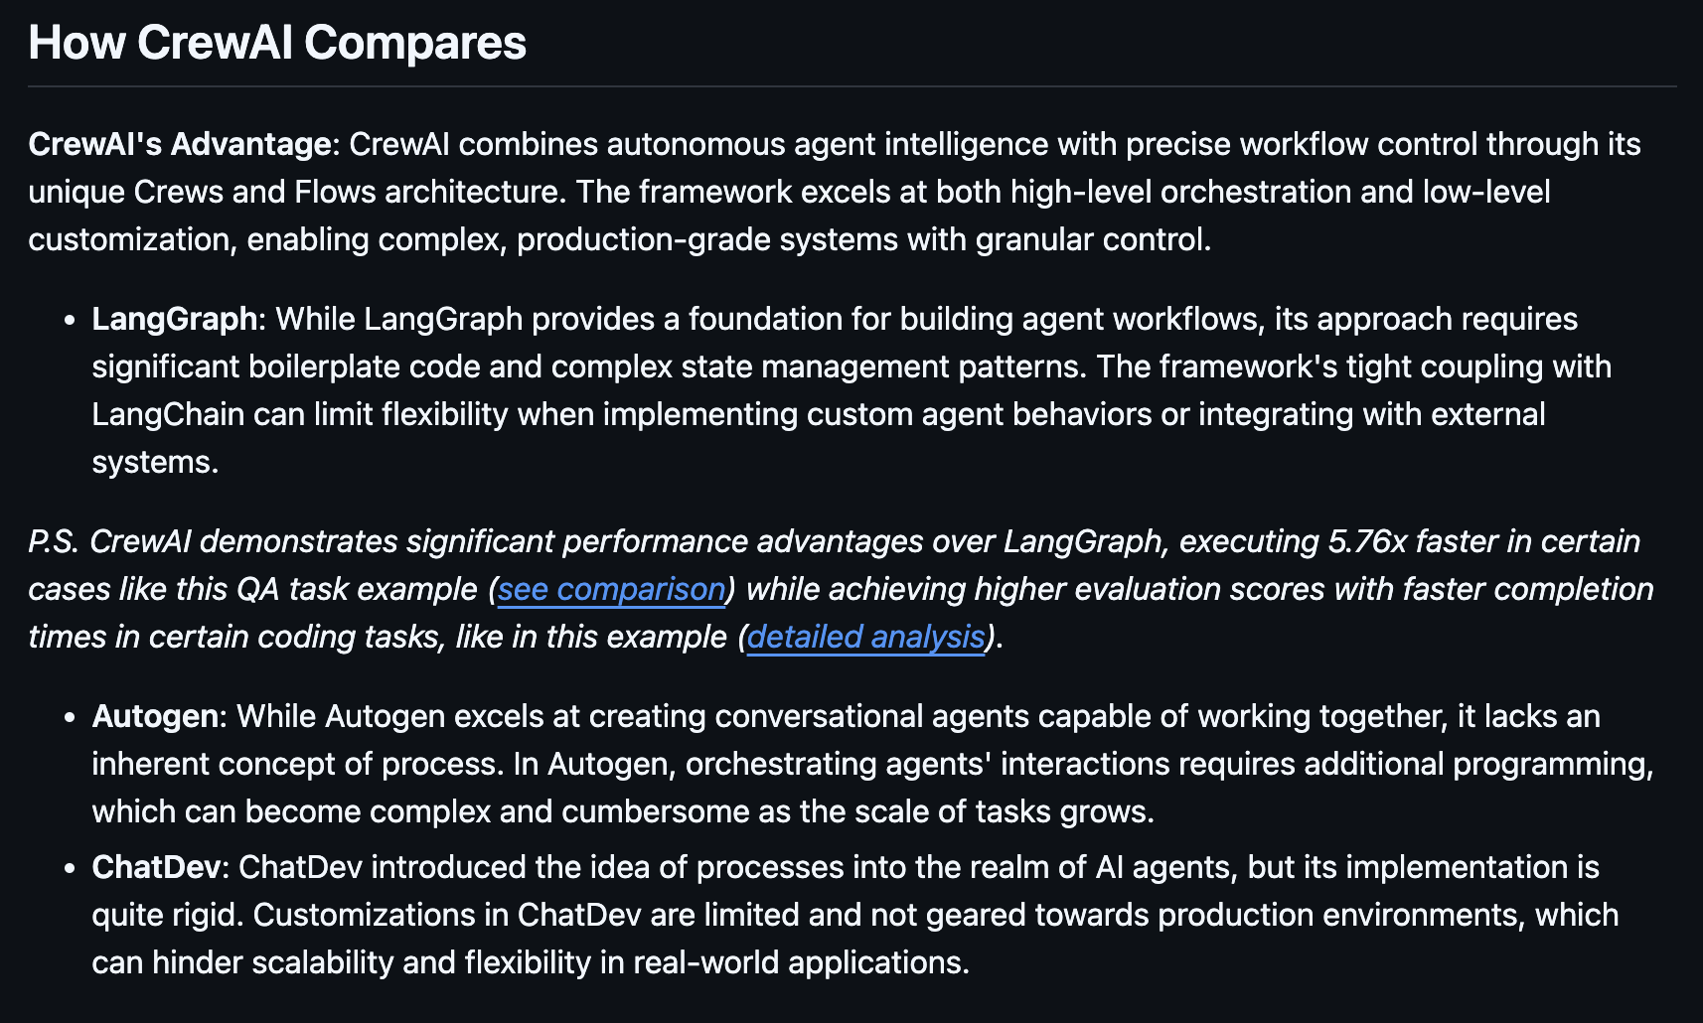
What CrewAI Says
https://github.com/crewAIInc/crewAI?tab=readme-ov-file#how-crewai-compares

Slide 80
Hands-on Tutorial

Slide 81
Assessment (14%)

Slide 82
Day 4: Deep-Dive into AI Gateway
Notes:
Create an alternate journey slide that has the process for a platform team buyer persona
Get Numbers for the usage thing to Nikunj
In the pipeline things mention that the
Elevance – platform
Otsuka –business
Pfizer – Business Team
Medidata – both business and platform
Team slide, put team wise and some logo – only few people
Add G2 Review slide
Add Public Recognition
Elevance guy quote – Elevance thing This foundry is unlike any other foundry
Other Google review and all
Unique insights
GTM Slides pick from email
Long Term Direction Slide
Auto Pilot (Product Screenshots)
Competitors thing add
Product Deep dive explaining the product -> Modules -> One important slide and 3-4 follow up slides kinda thing
Fundraise slide – How much etc.
Ingest customer stories from throughout

Slide 83
Module 7: Deep-Dive into AI Gateway

Slide 84
The Problem

Slide 85
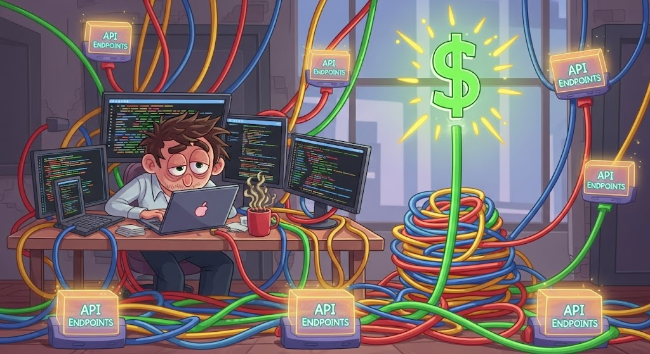
The Productionizing Nightmare
Prototyping with GenAI is easy.
Moving to production with a decentralized approach is messy.
This applies to both open-source and proprietary models.
Notes:
Prototyping with GenAI is relatively easy, but when you move from that simple prototype to a full-blown production application, things can get messy—fast. That mess is what we call the "productionizing nightmare." This applies regardless of whether you're using open-source or proprietary models. What "productionizing" essentially means is that it's not just about a cool demo or a quick experiment. It's about building something that is reliable, secure, and scalable enough to serve thousands of customers.

Slide 86
Real-Life Scenarios

Slide 87

Scenario 1
The Compliance & Audit Nightmare
The Problem: Your teams are handling sensitive data.
The Risk: Without a centralized, verifiable record of every prompt and response, you lack an auditable chain of custody.
The Impact: You cannot prove data was handled securely in a regulatory audit.
What if you had to tell your CEO
that a mission-critical AI project was on hold because your company could face a multimillion-dollar fine for non-compliance?
Notes:
Imagine a large financial services firm. Their legal team is using an AI application to summarize complex legal contracts—a process that handles highly sensitive client data. <The Problem> They’re using a third-party LLM for this task. While the vendor guarantees data privacy, the CISO and compliance teams raise a major red flag: there is no centralized, verifiable record of every prompt and response. <The Risk>If they face a regulatory audit, they have no way to prove exactly what data was sent to the model or what the model's output was. The company lacks the auditable chain of custody required for governance and compliance. <The Impact>The project is effectively dead on arrival until a solution can provide that forensic record. Think about it -

Slide 88
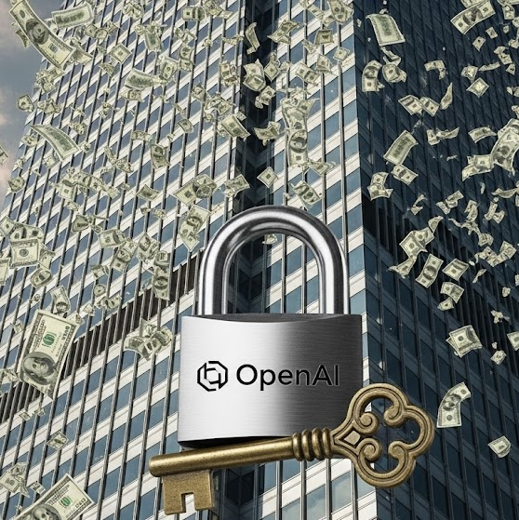
Scenario 2
Unpredictable Budget & Vendor Lock-in
The Problem: Each business unit manages its own budget and vendor contracts.
The Risk: No central way to monitor token usage or set granular spending caps.
The Impact: You're locked into a single vendor's pricing, making it impossible to switch when better options are available.
Imagine trying to explain to CFO
that your company's AI spend is growing by 30% month-over-month, and you have no way to prove which teams are responsible or how to rein it in.
Notes:
Now, imagine a massive e-commerce company with dozens of business units, all using various AI models for different tasks—from customer service chatbots to product description generation. Your budget is spiraling out of control. Each business unit is managing its own API keys and contracts with different vendors. <The Problem>There's no centralized way to monitor token usage or set granular spending caps. Worse, the teams are getting "locked in" to specific models. <The Risk> When a more cost-effective alternative becomes available or a vendor raises prices, the engineering effort required to switch models would be massive, essentially making it impossible. <The Impact>The company is losing its ability to negotiate better deals and optimize costs at scale, directly impacting the bottom line. Imagine -

Slide 89

Scenario 3
The Operational Continuity Crisis
The Problem: Your GenAI application relies on a single-point-of-failure—a single LLM provider.
The Risk: A third-party outage can bring your entire business to a halt.
The Impact: No automatic fallbacks or load balancing to ensure uptime, leading to lost revenue and reputational damage.
How do you explain to your board
that you have no disaster recovery plan for your most critical AI systems?
Notes:
Finally, let's look at a major automotive manufacturer that relies on a GenAI-powered in-vehicle assistant for navigation, conversational search, and real-time infotainment. This system uses a specific LLM as its central intelligence. <The Problem>At 3:00 AM, that single LLM provider experiences a system-wide outage. The in-vehicle assistant, which has a direct dependency on that one provider, becomes unresponsive. <The Risk> Customers can no longer use voice commands for navigation, entertainment, or even simple queries. The core functionality of a key customer-facing feature grinds to a halt. There are no automatic fallbacks to a secondary model, and no pre-arranged plan for business continuity <The Impact>. The company’s brand reputation and customer satisfaction are at risk due to a single-point-of-failure in its AI stack. Think about it -

Slide 90
Pain Points

Slide 91
The Problems Run Deeper
These critical business problems are caused by day-to-day technical complexities.
Your teams are facing a fragmented and chaotic AI stack for development, deployment and governance.
1. Integration Maze
2. Inconsistency and Versioning
3. Scalability and Reliability
4. Lack of Governance
5. Open-Source Integration
6. Observability Black Hole
Notes:
So what links these critical business problems together? <Click> The answer lies in the day-to-day technical complexities facing your developers. <Click> I will be highlighting 6 distinct issues here, but there are quite a few more!

Slide 92









1. Integration Maze
Problem: Developers write custom code for each new model.
Impact: Your system becomes fragile and difficult to maintain.
Risk: Switching to a new model requires a massive, time-consuming refactor.
Notes:
The most fundamental problem a developer faces is integration.
Say your team wants to compare different models (GPT4 vs Claude 3.7) for cost, or same model from different model providers (DeepSeek from its official API vs. from Groq) for latency, or in general just experiment for improving performance. They have to spend countless hours writing custom code for each model, each with its own API and SDK.
This makes your system fragile and a pain to maintain.
If a model goes down, or you want to switch to a cheaper one, you have to manually change code in every single application. That’s a massive refactor.

Slide 93
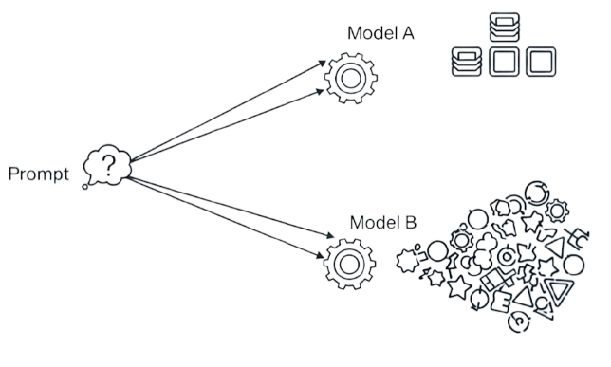
2. Inconsistency & Versioning
Problem: Prompts are hard-coded in different places.
Impact: You can't A/B test or ensure everyone is using the latest, most effective prompt.
Risk: The same prompt can produce unpredictable results depending on the model.
Consistent output
Inconsistent output
Notes:
Once a developer has solved the integration problem, they face the issue of managing prompts and getting consistent results across different models.
Your prompts—the instructions you give the AI—are often the most valuable part of your application. But without a central system, prompts are just hard-coded in different places.
You can't version them, A/B test them, or ensure everyone is using the latest, most effective version.
The same prompt can produce wildly different results depending on the model, leading to unpredictable responses.

Slide 94
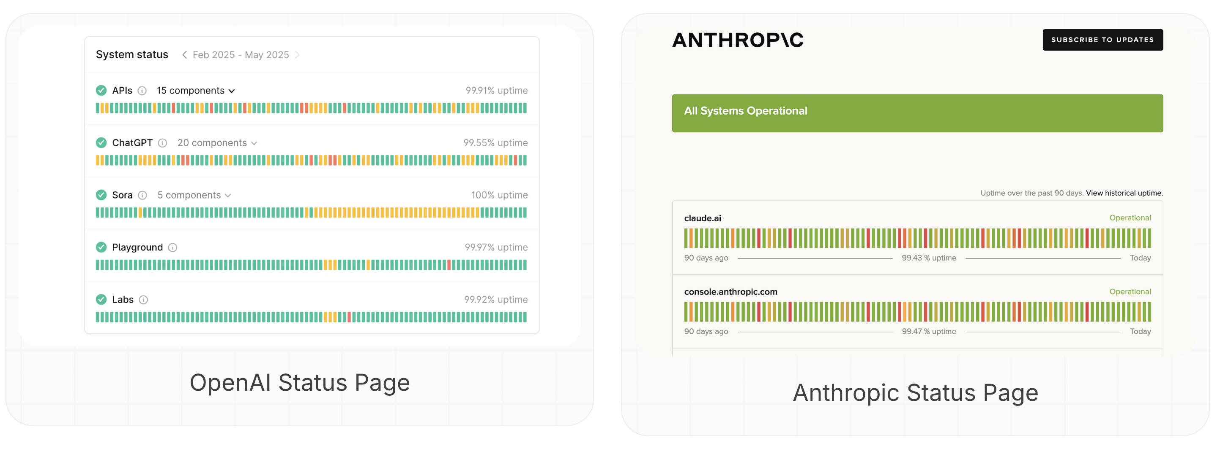
3. Scalability & Reliability
Problem: Your application is at the mercy of a single model provider.
Impact: You get hit with rate limits during traffic spikes, or deal with service outages.
Risk: You entire application can go down with it.
Notes:
After a team has a working prototype, their next concern is making it robust for real-world traffic, which is where the scalability and reliability becomes important.
As your user base grows, you need to be able to handle a high volume of requests. Your application might be a real-time chatbot or an AI-powered assistant, where predictable response times are crucial. But you’re solely at the mercy of your model provider.
What happens during a sudden traffic spike? You’re hit with rate limits.
Or there can also be service outages when an entire service like OpenAI or Anthropic goes down for maintenance.
What happens? Your whole application goes down for a while.

Slide 95
4. Lack of Governance
Problem: As you scale GenAI in your organization, you lose control over security, access, and costs.
Impact:
Security: You cannot apply a consistent security policy or centrally manage API keys.
Access: You cannot enforce a standard like Role-Based Access Control (RBAC).
Costs: You cannot set cost-based or token-based quotas for budget control.
Risk: Every team operates in a silo, and the risk of data leakage, unauthorized access, or accidental overspending skyrockets.
Notes:
This is a higher-level problem, that is the lack of governance.
As soon as you scale beyond a single project or team, you lose control over everything.
Security: There's no way to apply a consistent security policy across all your models. Also every model requires its own API key. Managing these keys, ensuring sensitive data isn't leaking to third parties, and staying compliant with regulations like GDPR or HIPAA becomes a huge risk.
Access: You can't set rate limits for specific users or enforce a standard like Role-Based Access Control (RBAC) to ensure that only authorized teams can access certain models.
Costs: On top of that, you can't enforce budget controls by setting cost-based or token-based quotas.
Every team becomes a silo, and the risk of data leakage, accidental overspending, or unauthorized access skyrockets. It’s a massive

Slide 96
5. Open-Source Integration
Problem: Integrating self-hosted, open-source models into an existing GenAI stack is a huge pain.
Impact: You have to handle all the infrastructure yourself (GPU scheduling, autoscaling, deployment) and lose the consistency of a unified API.
Risk: It becomes nearly impossible to manage both commercial and open-source models side-by-side.
Notes:
Now let’s more specifically consider Open-Source Integration. Leveraging hosted proprietary models is more streamlined – not necessarily cost-effective or more performant - than hosting your own open-source model. Many companies want to use self-hosted models like LLaMA for privacy or cost reasons.
But integrating these models into an existing GenAI stack is a huge pain.
You have to handle all the infrastructure yourself—GPU scheduling, auto-scaling, and deployment—and you lose the consistency of a unified API.
This makes it almost impossible to manage both commercial and open-source models side-by-side.

Slide 97

6. Observability Black Hole
Problem: When a request fails or a model hallucinates, you're flying blind.
Impact: You have no centralized way to debug.
Risk: You can't see the history, latency, or costs, making it impossible to troubleshoot and improve.
Notes:
Finally, there’s a huge observability black hole created from these problems.
When a user reports an issue, you can’t easily debug it.
You have no centralized logs to inspect the full request and response history, no way to filter metrics by team or environment, and no way to identify why a request failed.
You're left flying blind, making it nearly impossible to troubleshoot and optimize your applications.

Slide 98
The Solution: Enter AI Gateway

Slide 99


What is an AI Gateway
AI Gateway is a middle layer for all applications to talk to external/internal AI services. It eases the complexity of using GenAI with everything in one place - from security to costs.
Middle layer
It sits between user applications and any number of AI services
External/internal AI services
These can be anything from self-hosted to proprietary LLMs, or MCP servers
Notes:
An AI Gateway is a specialized middle layer that sits between your applications and the various AI models you use. It acts as a single, intelligent control point for all your AI traffic – managing everything like security, observability and governance, and thus makes it simple to scale GenAI apps reliably.
Architecturally, the AI Gateway is designed to solve the pain points we discussed by being a centralized layer. It simplifies your infrastructure by decoupling your applications from your external or internal AI services – this can self-hosted or proprietary LLMs or even MCP servers. This means your developers code to a single API endpoint, and the gateway handles the complexity behind the scenes. This centralized design is how you gain control over everything—from managing costs and security to ensuring reliability and performance.
Now let’s understand it visually. What’s happening here is that the AI gateway receives an API call from an application and then processes it before sending it to the correct LLM. This process can involve routing to appropriate model, or, translating the request from the application's format into the specific API format required by the target model, or adding necessary API keys or tokens required by specific LLM for authentication and authorization, or caching to check if a similar request has been made before to return a cached response to save time and money without needing to call the LLM again.
In essence, the AI gateway transforms a generic API call into a model-specific API request, acting as a bridge.

Slide 100
Diving Deeper into AI Gateway
AI Gateway is a specialized middleware component and egress proxy that serves as a centralized control plane providing a unified observable interface for the entire GenAI stack.
Middleware
Abstraction layer between user apps and LLM APIs
Operates at application level
Middle position in stack
Egress Proxy
Reverse proxy, manages outbound traffic (apps to LLMs)
Data plane, at network level
This defines the direction of traffic
Centralized Control Plane
Consolidates all application-level traffic into single point
Control plane, at network level
This is controller directing all traffic
Unified Observable Interface
Provides centralized policy enforcement and full observability
Single user-friendly API at application level
This is the final benefit of the AI Gateway
Notes:
"Now, let's get a little more technical and look at the real architectural definition. AI Gateway is a specialized middleware component that functions as a centralized control plane and egress proxy, providing a unified interface for your entire GenAI stack.
Let's break down what those terms really mean.
First, middleware - The AI Gateway sits between your applications and LLM APIs, abstracting away provider-specific logic. It operates at the application layer, offering a clean, consistent integration surface regardless of which model or provider you're using.
Because it is in this prime middle position, it is able to act as an Egress Proxy. Specifically, this means the AI Gateway manages outbound traffic — routing requests from your internal applications to external LLM providers like OpenAI or Anthropic. It operates at the data plane, at the network level.
Now merging the 2 concepts make it a Centralized Control Plane, which is the core of the AI Gateway. By consolidating all application-level traffic from your organization, you get a network-level capability. All your AI requests are funneled through this one hub. This is the single point where you can gain complete control over your entire GenAI stack. It acts like the traffic controller.
And finally, the final benefit is a Unified Observable Interface for GenAI at scale. You can easily enforce policies, monitor usage, and route requests intelligently.
The centralized control plane provides a single, standardized API for all your developers and applications to use, abstracting away the underlying complexity of each individual LLM.

Slide 101

API Gateway vs. AI Gateway
API Gateway is primarily an ingress proxy. AI Gateway is typically an egress proxy.
Notes:
Chapter 5: Now, you might be thinking, isn't this just an API Gateway? That's a great question, but they are designed to be fundamentally different.
A traditional API Gateway functions as an ingress proxy. Its primary job is to be the single, secure front door for all inbound traffic. It handles all the requests coming into your system and protects your internal microservices by managing authentication, load balancing, and rate limiting. It's designed to secure your system from the outside world.
An AI Gateway, on the other hand, is a completely different kind of system. It's an egress proxy, which means it manages all the outbound traffic coming from your system. Its job is to handle the unique and complex challenges of consuming AI models, which a standard API Gateway is not built for. Things like token-based rate limiting for cost management, semantic caching to reduce redundant calls to expensive models, or model orchestration like intelligently routing requests to different LLMs.
That said, both can be configured to proxy either direction - the distinction between the two is not a hard technical limitation, but a difference in purpose-built design, feature sets, and usage patterns.

Slide 102
Key Features

Slide 103
Centralized Access and Enterprise-Grade Security
🔗 Unified Access
Connect to multiple LLM providers (e.g., OpenAI, Anthropic, Cohere, in-house models) via a single API — no need to manage individual SDKs, endpoints, or API keys.
🔐 Authentication & Authorization
Enforce secure access with centralized key management. Developers get scoped API keys & root credentials stay secure with tools like AWS SSM, GCP Secret Manager, or Azure Vault.
🧑‍💼 Role-Based Access Control (RBAC)
Control who can access what — down to specific models or operations — ensuring compliance with enterprise security standards.
Notes:
Let's begin with the foundation — access and control.
First, the AI Gateway offers Unified Access. Instead of juggling multiple APIs and keys, teams use a single API interface to connect with OpenAI, Anthropic, Cohere, or even internal models. This drastically reduces complexity.
Then there’s Authentication and Authorization. Keys are centrally managed. Developers receive scoped API keys, and root credentials stay secure via services like AWS SSM or Azure Vault.
Add to that Role-Based Access Control, or RBAC — which enforces fine-grained permissions across users, teams, or model types — ensuring your GenAI infrastructure aligns with enterprise security standards.

Slide 104
Smart Routing, Fallbacks, and Load Management
🔁 Routing & Fallbacks
Route requests based on latency, cost, or model reliability. Automatically retry or failover to alternate providers when needed.
⏱️ Rate Limiting & Load Balancing
Enforce quotas per user or team, and balance load across providers to ensure high availability and fairness.
🧠 Caching
Reduce latency and token spend by caching repeated prompts and responses — improving performance without sacrificing accuracy.
Notes:
Once access is in place, the next step is to intelligently manage traffic.
Routing and Fallbacks allow you to direct traffic based on performance, cost, or provider availability. If one model is slow or down, the gateway can automatically retry with another — improving resiliency without requiring manual intervention.
Then there’s Rate Limiting and Load Balancing. You can configure quotas at the user or team level, and balance traffic across providers to maintain throughput and stability — especially important under heavy load.
And with Caching, the gateway can store responses to repeated prompts — saving on tokens and reducing latency for common queries.

Slide 105
Full Visibility into LLM Performance and Usage
📊 Performance Monitoring
Track latency, error rates, and token throughput per model endpoint — enabling SLA adherence and early issue detection.
📈 Usage Analytics
View detailed logs and dashboards showing who accessed which model, when, and how — helping teams understand adoption and behavior.
💰 Cost Management
Attribute token-level costs to users, teams, or features. Prevent budget overruns and gain transparency into model spend.
Notes:
Once traffic is flowing, you need visibility — and this is where AI Gateways shine.
With Performance Monitoring, you can track latency, token throughput, and error rates per model or endpoint. This helps you identify bottlenecks and maintain SLAs.
Then there’s Usage Analytics. You get detailed logs and dashboards that show who used what model, when, and how — enabling cross-team transparency and better collaboration.
And critically, Cost Management. Since token usage is tracked per user, team, or endpoint, you can attribute costs precisely and stay ahead of budget overruns.

Slide 106
Built to Plug into Your GenAI Stack
🔌 API Integrations
Easily connect to tools like evaluation pipelines, prompt guardrails, vector databases, or monitoring platforms.
🧬 Custom Model Support
Bring your own fine-tuned or proprietary models into the Gateway — run them alongside commercial providers with a consistent interface.
🧩 Composable Architecture
Designed to extend with your workflows, tools, and compliance stack — from dev sandboxes to production deployments.
Notes:
AI Gateways aren’t just about control — they’re also designed for extensibility.
Through API Integrations, you can plug in tools like evaluation pipelines, prompt moderation layers, or vector databases — enriching your LLM workflows without additional glue code.
And with Custom Model Support, you can bring your own fine-tuned or proprietary models into the gateway — giving them the same interface and policy enforcement as hosted models like GPT-4 or Claude.
This makes the gateway a composable layer that fits into your existing AI/ML ecosystem — whether you're in R&D or managing production-scale deployments.

Slide 107
Why AI Gateway Matters
✅ One gateway to rule all LLMs
🛡️ Enforced security, roles, and cost controls
🔁 Intelligent routing, caching, and fallbacks
📊 Full observability into usage and performance
⚙️ Plug-and-play with your AI/ML ecosystem
AI Gateway provides a structured and scalable foundation for enterprise GenAI!
Notes:
To recap:
AI Gateway is the one gateway to rule and govern all LLM calls
It centralizes access and enforces enterprise-grade security
It routes and manages traffic intelligently, with fallbacks and caching
It offers full observability and cost tracking across teams
And it integrates cleanly with your tools, workflows, and custom models
Altogether, it provides a structured, scalable foundation for enterprise GenAI.

Slide 108
Revisiting Scenarios with AI Gateway

Slide 109
How AI Gateway Resolves the Real Risks
The Risk: ❌ No centralized logs = No audit trail ❌ Exposure to regulatory non-compliance
Solved by AI Gateway: ✅ Unified logging of prompts & responses ✅ Role-based access control
The Risk: ❌ No cost visibility, no controls = runaway spend ❌ Locked into a single LLM vendor
Solved by AI Gateway: ✅ Token-level cost tracking by team/user ✅ Usage analytics + spending caps ✅ Multi-vendor routing + abstraction
The Risk: ❌ Single provider failure = business outage ❌ No fallback or DR (disaster recovery) strategy for GenAI
Solved by AI Gateway: ✅ Multi-provider routing + auto-fallbacks ✅ Load balancing across endpoints ✅ Built-in caching for resilience
Key Takeaway: AI Gateway isn’t just infrastructure — it’s how you make GenAI safe, scalable, and enterprise-ready.
Notes:
Let’s revisit the three real-world risks we started with.
First — Compliance and Audit. Without audit logs, you're flying blind in front of regulators. With AI Gateway, every prompt and response is logged, secured, and attributable — making compliance automatic, not optional.
Second — Budget Chaos and Lock-In. When spend is invisible, it’s unmanageable. The Gateway gives you fine-grained cost tracking and enforces usage controls, while letting you route across vendors without lock-in.
And third — Operational Risk. A single LLM dependency is a single point of failure. The Gateway introduces failovers, load balancing, and caching — keeping your AI applications resilient and always on.
In short: every risk scenario we opened with now has a clear, scalable solution.
Chapter 8:
And that’s the big picture — not just what an AI Gateway does, but why it matters.
You wouldn’t deploy software without version control or observability — why deploy GenAI without an AI Gateway?
The key takeaway I want to leave you with is that AI Gateway isn’t just infrastructure — it’s how you make GenAI safe, scalable, and enterprise-ready. It closes the gaps in compliance, spend, and reliability — and creates a foundation where GenAI can grow with confidence in your organization, and drive real value, not just expected value.

Slide 110
Overview of Features

Slide 111
TrueFoundry AI Gateway is a centralized control plane for Agentic AI, that manages interactions between LLMs & applications with unified access, security, observability, control.
Capabilities of AI Gateway
RAG, Agents, Chatbots <Gateway> LLM Models, Tools, Agents
Tracing
- Audit each step of the complex workflow
- For RAG/Agent Building
Security & Access Controls
Centralized API key management
RBAC and Audit Trail
Rate Limiting and Throttling
Fallback and Load Balancing
Fallover for high availability
Load balance for cost/quality
Guardrails
PII Risks
Bias/Fairness policies
Caching & Optimization
- Semantic caching for repeated prompts
Cost and Usage Monitoring
Monitor cost from one pane
Complete prompt <> Response logging

Slide 112
Hands-on Tutorial

Slide 113
Assessment (14%)

Slide 114
Day 5: Deployment and Evaluations
Notes:
Create an alternate journey slide that has the process for a platform team buyer persona
Get Numbers for the usage thing to Nikunj
In the pipeline things mention that the
Elevance – platform
Otsuka –business
Pfizer – Business Team
Medidata – both business and platform
Team slide, put team wise and some logo – only few people
Add G2 Review slide
Add Public Recognition
Elevance guy quote – Elevance thing This foundry is unlike any other foundry
Other Google review and all
Unique insights
GTM Slides pick from email
Long Term Direction Slide
Auto Pilot (Product Screenshots)
Competitors thing add
Product Deep dive explaining the product -> Modules -> One important slide and 3-4 follow up slides kinda thing
Fundraise slide – How much etc.
Ingest customer stories from throughout

Slide 115
Module 8: Deployment with TrueFoundry

Slide 116
Hands-on Tutorial

Slide 117
Module 9: Evaluating LLM Applications

Slide 118
Why Evaluate at All?
Evaluation helps address and identify the bottlenecks related to:
Hallucinations (absence of relevant context in final prompt is the most common reason for this, but there could be others)
Reduced reasoning capabilities (if all the relevant context is not provided to LLM, it can lead to this)
Unexpected latencies (what would happen is the retrieval might not be efficient leading to high latencies)
Explainability of outputs (i.e., was performance bad due to the LLM itself or due to other aspects of the application – think agents, RAG, agentic RAG etc.)
It also helps build trust among users especially for use in high-stakes industries like Finance, Healthcare etc.
And in general, it is a best practice for building any kind of an “AI” application.

Slide 119
Evaluating a RAG Application
Typically we think of evaluating only the outputs. And if the result is poor, we might attribute it to the LLM itself.
However, remember such an LLM application is based off RAG, and instead of only focusing on “G” = Generation, we need to also evaluate the “R” = Retrieval which is the other main pillar of such an application.
Output vs. Output Evaluation
Context vs. Context Evaluation
Generated Output
Judge
Correct Output
Retrieved Context
Judge
Correct Context
But even then, with the correct context, sometimes the LLM doesn’t ground the output in the context leading to hallucinations!
SOLUTION: There are a lot of evaluation metrics that help address these varied issues.

Slide 120
LLM-as-a-Judge Paradigm
As we discussed, there are more dimensions than just output vs. output evaluation.
But HOW do we do this?
Judge can be
Human (pros: super good; cons: time-expensive, not scalable)
a Statistical NLP based method (pros: deterministic, scalable; cons: limited in semantic capabilities)
an LLM itself! = LLM as a Judge! (pros: good semantic capabilities, scalable; cons: scale comes with cost, black box/hallucination could potentially occur)
Multiple Dimensions
Who is the Judge?
Multiple Dimensions

Slide 121
Overview of Evaluation Metrics
Now let’s see an overview of evaluation metrics, and the dimensions each of these is designed to evaluate.
Dimensions
S.No. | Metric | User Question | Ground Truth Context | Retrieved Context | Actual Answer | Generated Answer
1 | Context Precision@k | ❌ | ✅ | ✅ | ❌(✅) | ❌
2 | Context Recall | ❌ | ✅ | ✅ | ❌(✅) | ❌
3 | Faithfulness | ❌ | ❌ | ✅ | ❌ | ✅
4 | Answer Relevancy | ✅ | ❌ | ❌ | ❌ | ✅
5 | Prompt Alignment | ✅ | ❌ | ❌ | ❌ | ✅
6 | Toxicity | ❌ | ❌ | ❌ | ❌ | ✅
Retrieval
Metrics
Generation Metrics
We’ll deep-dive into S.No. 1-6 using the popular frameworks RAGAs and DeepEval in Python.

Slide 122

Evaluation Metric 1: Context Recall
Key Takeaway
Out of the relevant available context, how much relevant context is retrieved?
(can be done using actual answer also, instead of ground truth context)
User Question | Ground Truth Context | Retrieved Context | Actual Answer | Generated Answer
❌ | ✅ | ✅ | ❌(✅) | ❌
Definition
$$Context Recall=\frac{Number of claims in the reference supported by the context}{Total number of claims in the reference}$$
Code Snippet
(RAGAs)
Output
1.0
Relative Cost of Evaluation
Small to medium depending on system prompt length

Slide 123



Evaluation Metric 2: Context Precision@k
Out of the all context that’s retrieved, how much context is relevant and ranked higher than irrelevant ones?
(can be done using actual answer also, instead of ground truth context)
User Question | Ground Truth Context | Retrieved Context | Actual Answer | Generated Answer
❌ | ✅ | ✅ | ❌(✅) | ❌
Key Takeaway
$$Precision@k=\frac{true positives@k}{(true positives@k+false positives@k)}$$
Definition
$$Context Precision@k=\frac{\sum_{k=1}^{K}{(Precision@k ×v_{k})}}{Total number of relevant items in the top K results}$$
Code Snippet
(RAGAs)
Output
0.5
Relative Cost of Evaluation
Small to medium depending on system prompt length

Slide 124

Evaluation Metric 3: Faithfulness
Key Takeaway
How much of the generated answer is attributed to the retrieved context, versus, the model’s own knowledge base?
User Question | Ground Truth Context | Retrieved Context | Actual Answer | Generated Answer
❌ | ❌ | ✅ | ❌ | ✅
Definition
$$Faithfulness Score=\frac{Number of claims in the response supported by the retrieved context}{Total number of claims in the response}$$
Code Snippet
(RAGAs)
Output
1.0
Relative Cost of Evaluation
Small to medium depending on system prompt length

Slide 125



Evaluation Metric 4: Answer Relevancy
Key Takeaway
How relevant is the response generated by the LLM, compared to what the user had originally asked?
User Question | Ground Truth Context | Retrieved Context | Actual Answer | Generated Answer
✅ | ❌ | ❌ | ❌ | ✅
Definition
$$Answer Relevancy=\frac{1}{N}\sum_{i=1}^{N}{cosine similarity(E_{g_{i}, }E_{a})}$$
$$Answer Relevancy=\frac{1}{N}\sum_{i=1}^{N}{\frac{E_{g_{i}}∙ E_{a}}{||E_{g_{i}}||||E_{a}||}}$$
$$by default, 3 questions (i.e., N=3) are generated by the LLM but this parameter can be changed$$
Code Snippet
(RAGAs)
Output
0.56
Relative Cost of Evaluation
Medium to large as multiple LLM calls are involved

Slide 126


Evaluation Metric 5: Prompt Alignment
Key Takeaway
How well did the generated answer follow the instructions mentioned in the prompt?
User Question | Ground Truth Context | Retrieved Context | Actual Answer | Generated Answer
✅ | ❌ | ❌ | ❌ | ✅
Definition
$$Prompt Alignment=\frac{Number of instructions followed}{Total number of instructions}$$
Code Snippet
(DeepEval)
Output
1.0
Relative Cost of Evaluation
Medium to large as multiple LLM calls are involved
By default it’s 2 (1. Checks the no. of instructions which were followed in the generated answer
2. Generates a reason for the score calculated given the verdict for the opinions for the
instructions which were not followed)

Slide 127


Evaluation Metric 6: Toxicity
Key Takeaway
Measures how toxic the generated response is, in terms of number of opinions.
User Question | Ground Truth Context | Retrieved Context | Actual Answer | Generated Answer
❌ | ❌ | ❌ | ❌ | ✅
Definition
$$Toxicity=\frac{Number of toxic opinions}{Total number of opinions}$$
Code Snippet
(DeepEval)
Output
1.0
Relative Cost of Evaluation
Medium to large as multiple LLM calls are involved
By default it’s 3 (1. Call to generate all the opinions in the generated answer
2. Checks which opinions are toxic
3. Generates a reason for the score calculated given the toxic opinions)

Slide 128
Assessment (14%)

Slide 129
Certification Test (30%)

